Slide 1
Process Documentation of Website Hosting with High Availability & Fault Tolerance

Slide 2
Services used for Project
1.IAM (Identity & Access Management)
- Users
2.VPC (Virtual Private Cloud)
- VPC & Subnets
- Internet Gateway & NAT Gateway
- Route Tables
3.EC2 (Elastic Compute Cloud)
- Template , Auto Scaling Groups
- Load Balancer, Target Group
- Instance
4.S3 (Simple Storage Service)
- Bucket

Slide 3
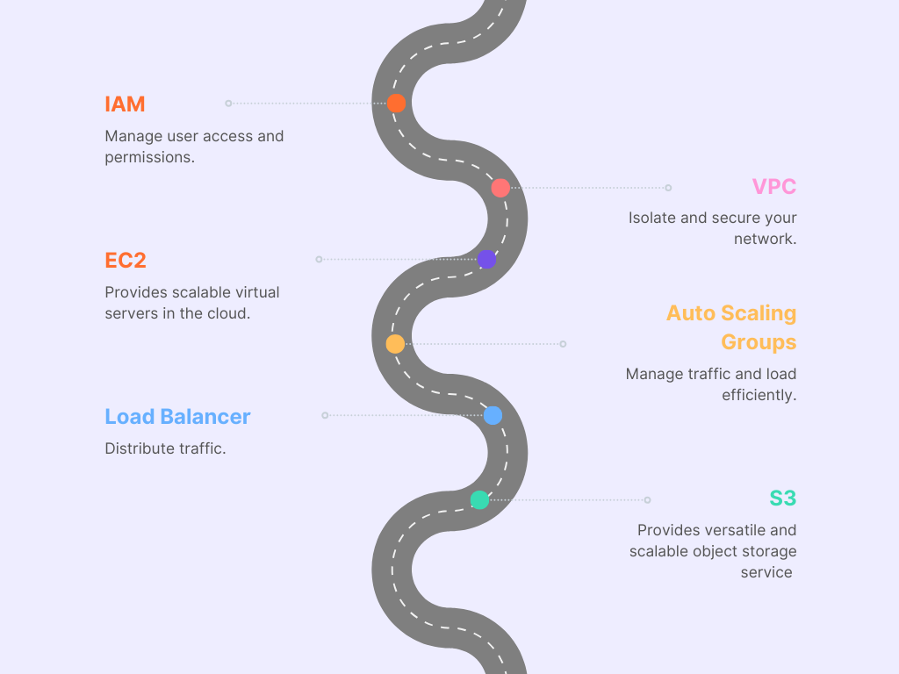
Flowchart of the Project

Slide 4
1.Sign-in to AWS Root Account
1.Search for AWS Management Console.
2.Open to the AWS Management Console.
3.Click on “Sign In to the Console”.
4.Choose “Root user” as the login method.
5.Enter Email and Password that is associated with your AWS root account.
6.Click on Sign in.

Slide 5
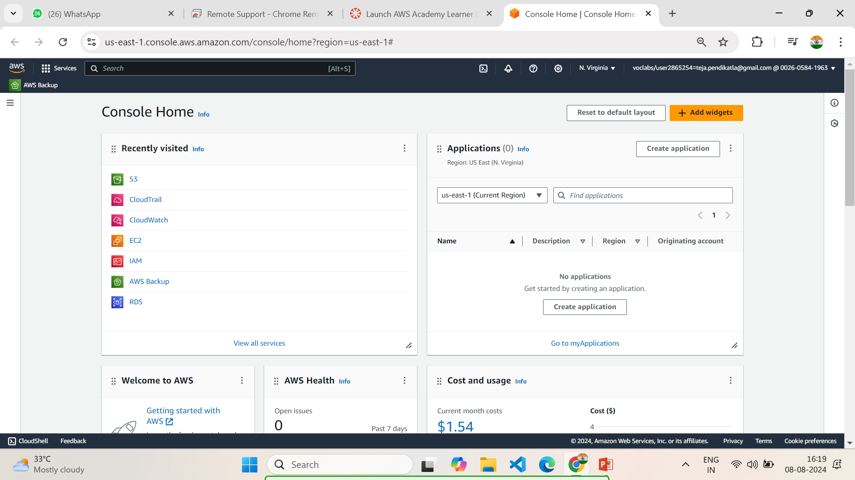
1.1 AWS Console Home

Slide 6
2.SETTING UP IAM
1.Open AWS dashboard in AWS Management Console.
2.Search for IAM in Search bar and open IAM dashboard.
3.Go to Users and create the number of users based on your requirement ,we don’t have the requirement to create a Group as of now, because we are creating a single IAM user.
4.Configure the name of the user , and Click on Checkmark - Custom password and Click on Checkmark User must create a new password at next sign-in.
5.Now Select - Attach Policies Directly in Permission Options and Search the required permissions for the IAM user account that we are creating.
6.Now we are Selecting required permissions to our IAM user based on our project requirements in Permissions Policies.
7.IAM Full Access,AmazonEC2FullAccess,AmazonVPCFullAccess,AmazonS3FullAccess.
8.After selecting the permissions click on Create user.

Slide 7
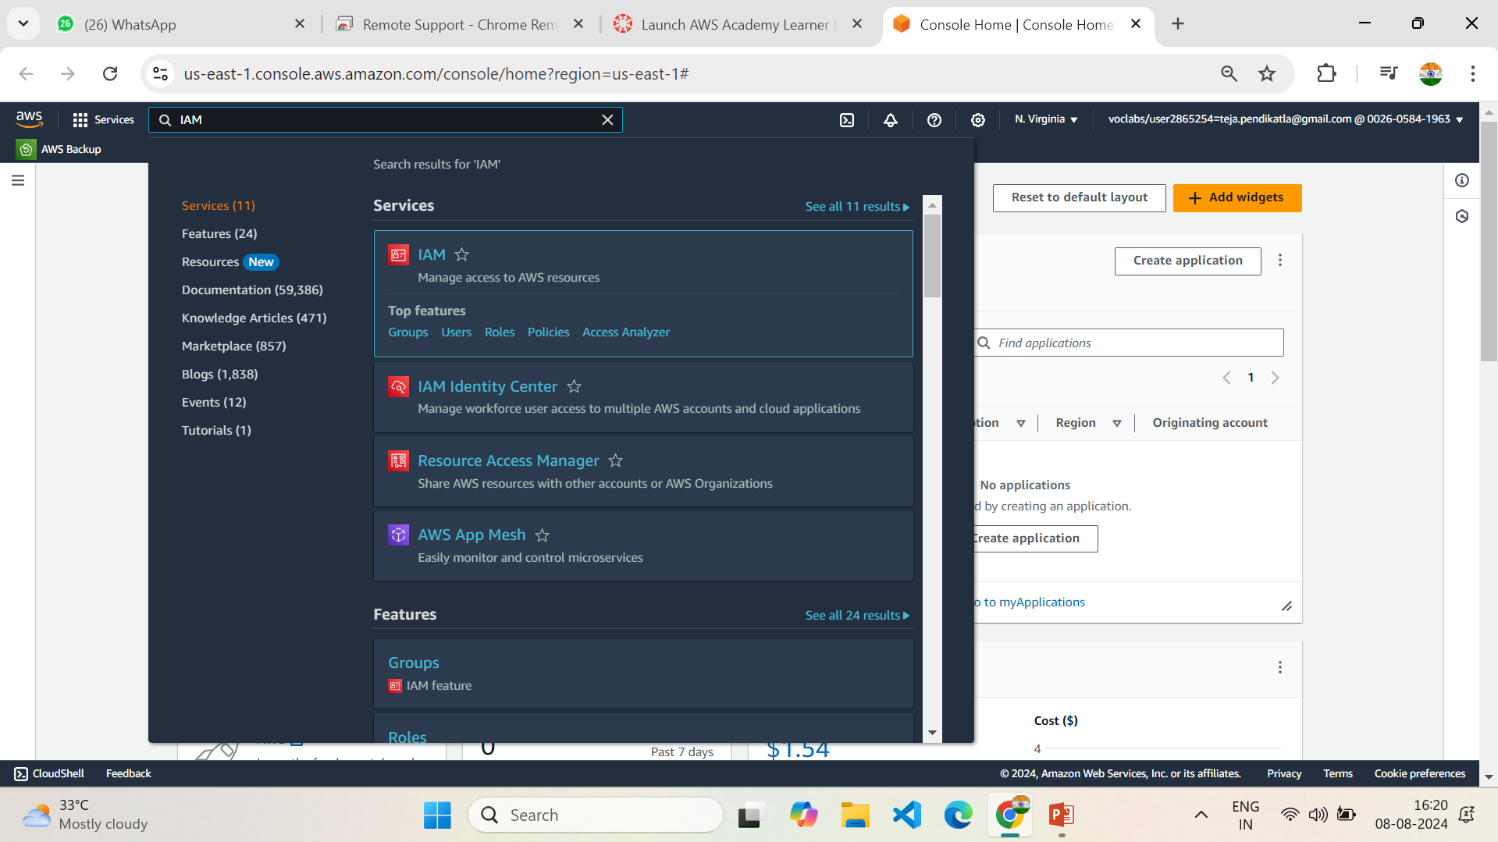
2.1 Search for IAM Services in AWS Console Home

Slide 8
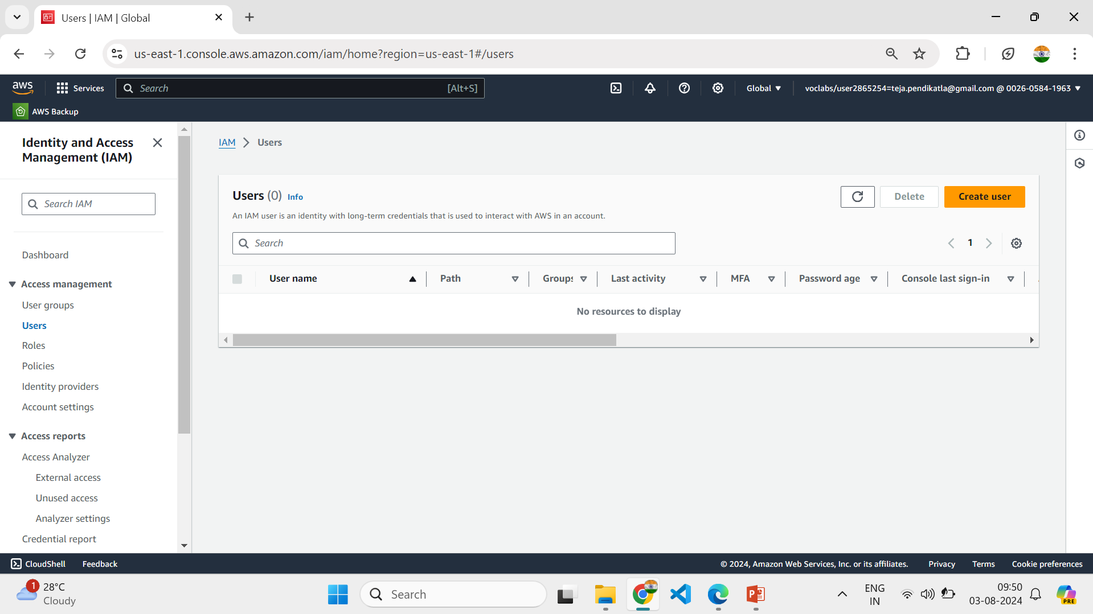
2.2 Create New User in IAM Dashboard

Slide 9
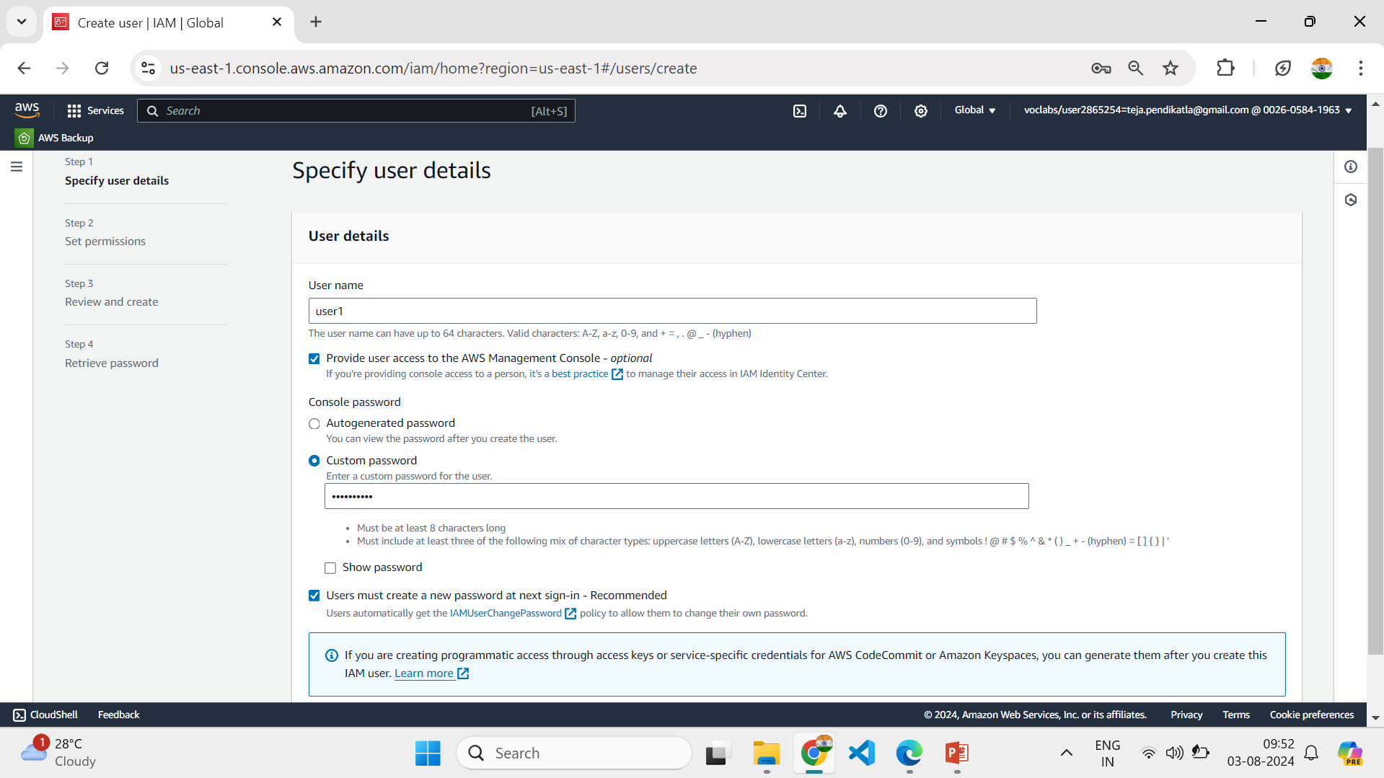
2.3 Custom User name and follow the steps in IAM Creation

Slide 10
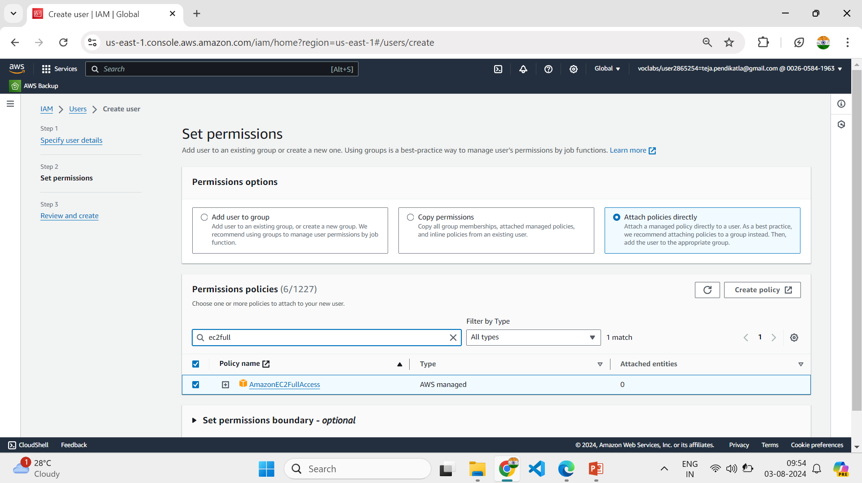
2.4 Select Permissions option and search for appropriate Permissions

Slide 11
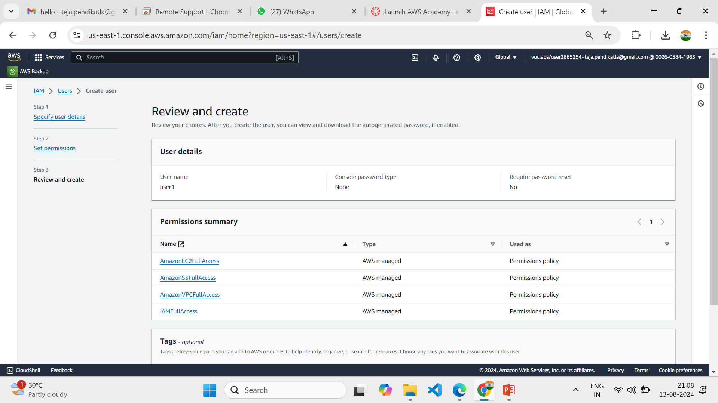
2.5 Select the following Permissions and Click on Create user

Slide 12
3.SETTING UP VPC
1.Open AWS dashboard in AWS Management Console.
2.Search for VPC in Search bar and open VPC dashboard.
3.Click on create VPC ,Now select VPC only in VPC Settings and give a name to your VPC.
4.Select IPV4 CIDR – (10.0.0.0/26 , the block size is 64 Class C), and click on Create VPC.
5.In VPC dashboard now click on Subnets(We require 2 subnets based on requirement).
6.Select the created VPC in VPC ID , while creating subnet - Subnet 1 was created with subnet name as publicsubnet , under the region us-east-1a, IPv4 VPC CIDR Block :10.0.0.0/24, IPv4 Subnet CIDR Block 10.0.0.32/27 .
7.Subnet 2 was created with subnet name as privatesubnet , under the region us-east-1b , IPv4 VPC CIDR Block :10.0.0.0/24, IPv4 Subnet CIDR Block 10.0.0.64/27 .
8.Two Subnets are successfully created in your VPC.

Slide 13
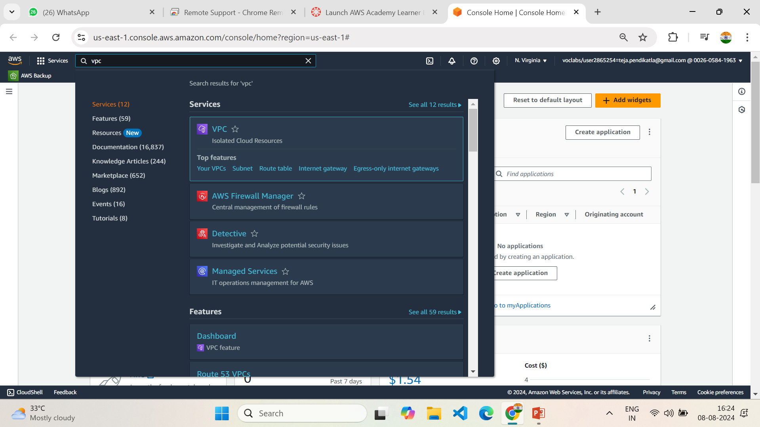
3.1 Search for VPC Services in AWS Console Home

Slide 14
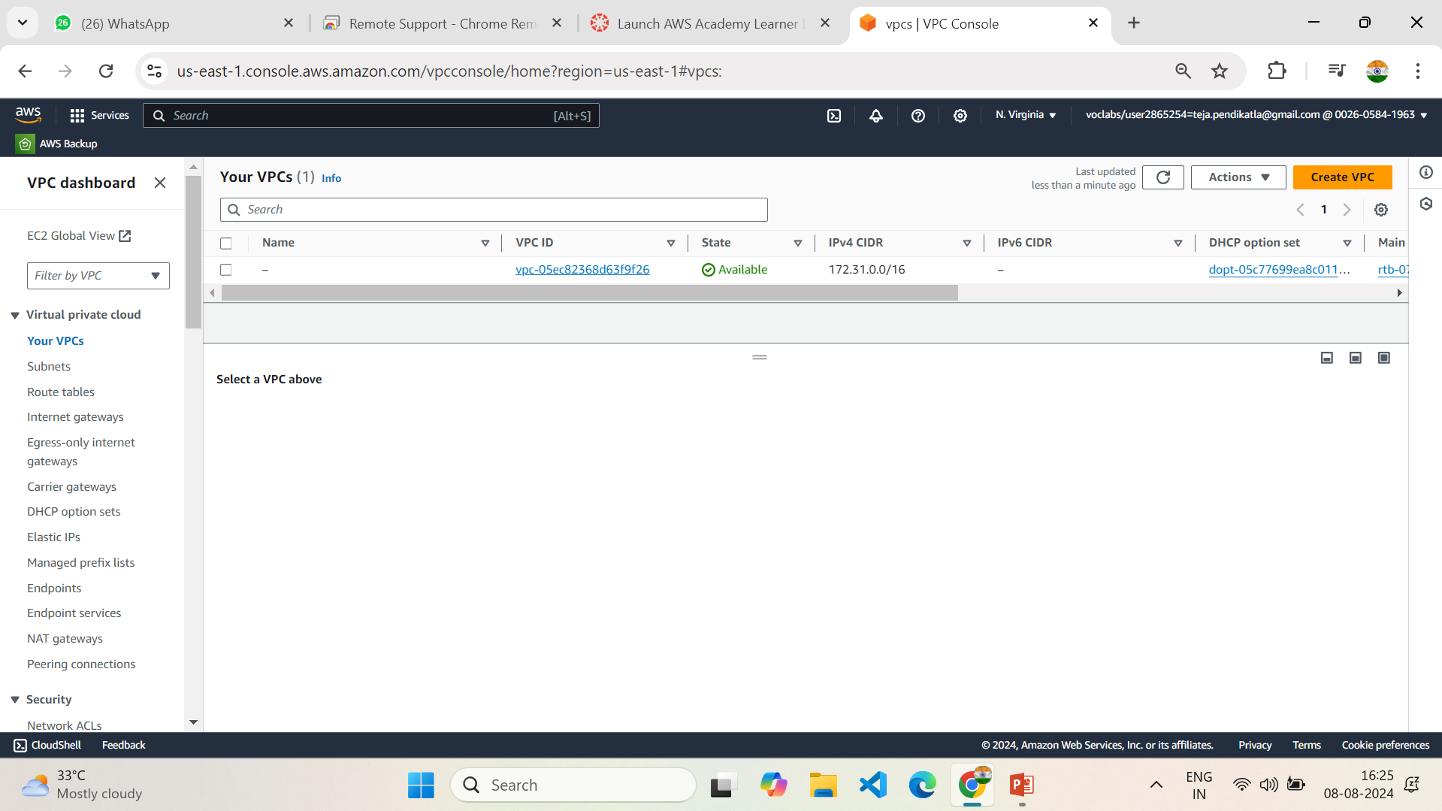
3.2 Come to VPC Dashboard & Create VPC

Slide 15
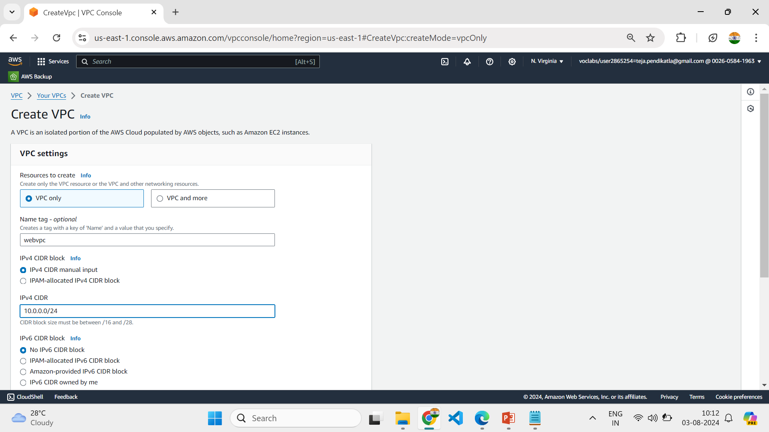
3.3 Follow the steps in Setting up VPC

Slide 16
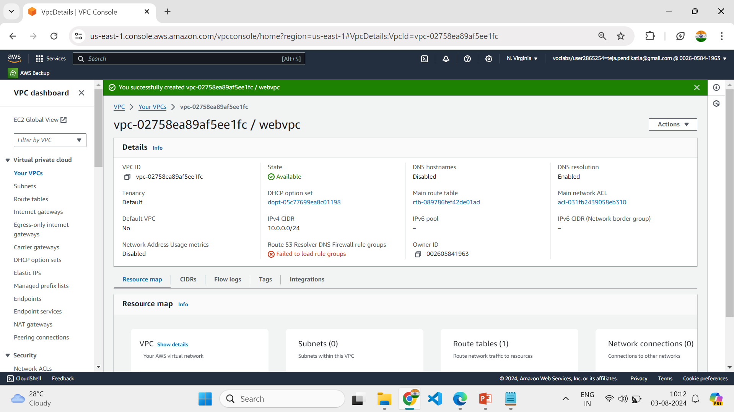
3.4 VPC named “webvpc” is created Successfully

Slide 17
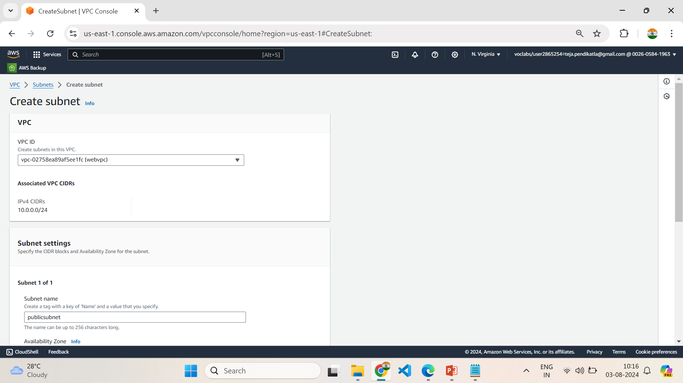
3.5 Select the Created VPC in VPC ID & follow the steps in setting up

Slide 18
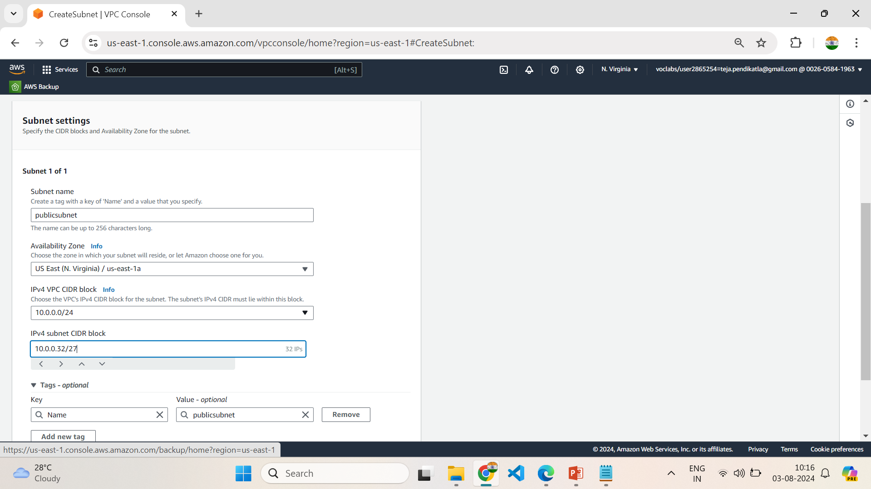
3.6 Setting up Public Subnet in VPC & follow Setting up VPC

Slide 19
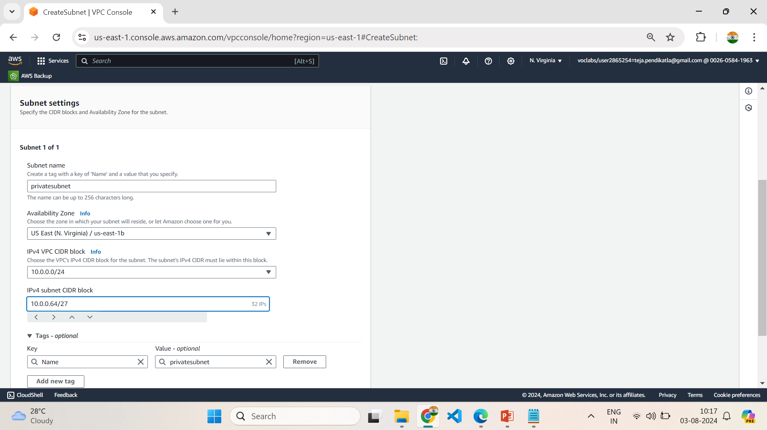
3.7 Setting up PrivateSubnet in VPC

Slide 20
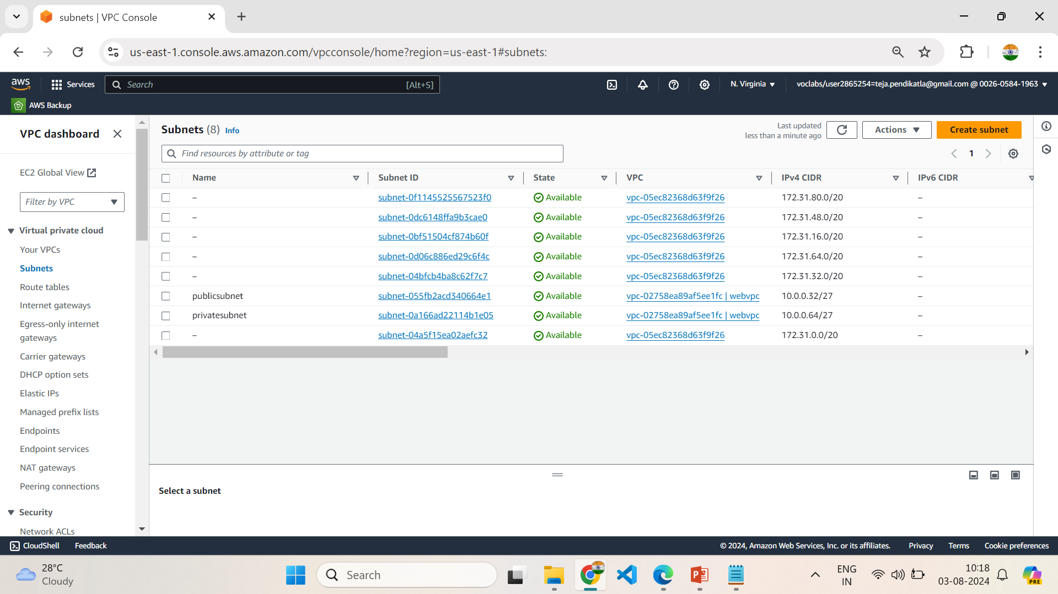
3.8 Two subnets are Created Successfully in VPC

Slide 21
4.Setting Up Internet Gateway
1.In VPC dashboard ,Select Internet Gateway.
2.Create an Internet Gateway, give a name in name tag in internet gateway setting.
3.Create the Internet Gateway.
3.Click on the pop up or click on actions in top right corner to Attach to a VPC.
4.Select already created VPC in Available VPC’s and click on Attach Internet Gateway.
5.Internet Gateway is successfully attached to the existing or created VPC.

Slide 22
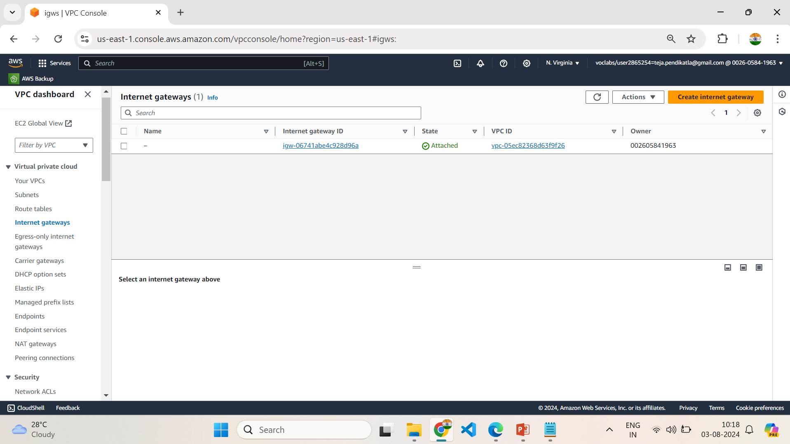
4.1 Create Internet Gateway

Slide 23
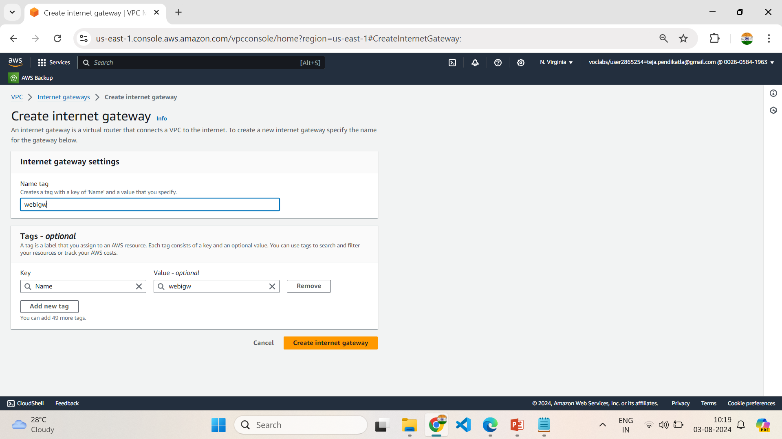
4.2 Give a name to InternetGateway

Slide 24
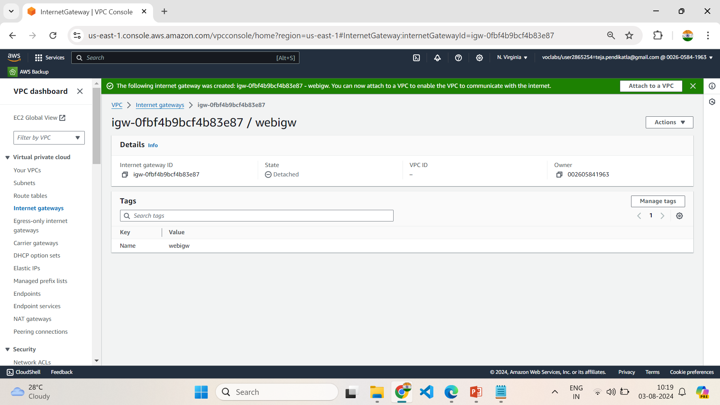
4.3 Click on Attach to a VPC

Slide 25
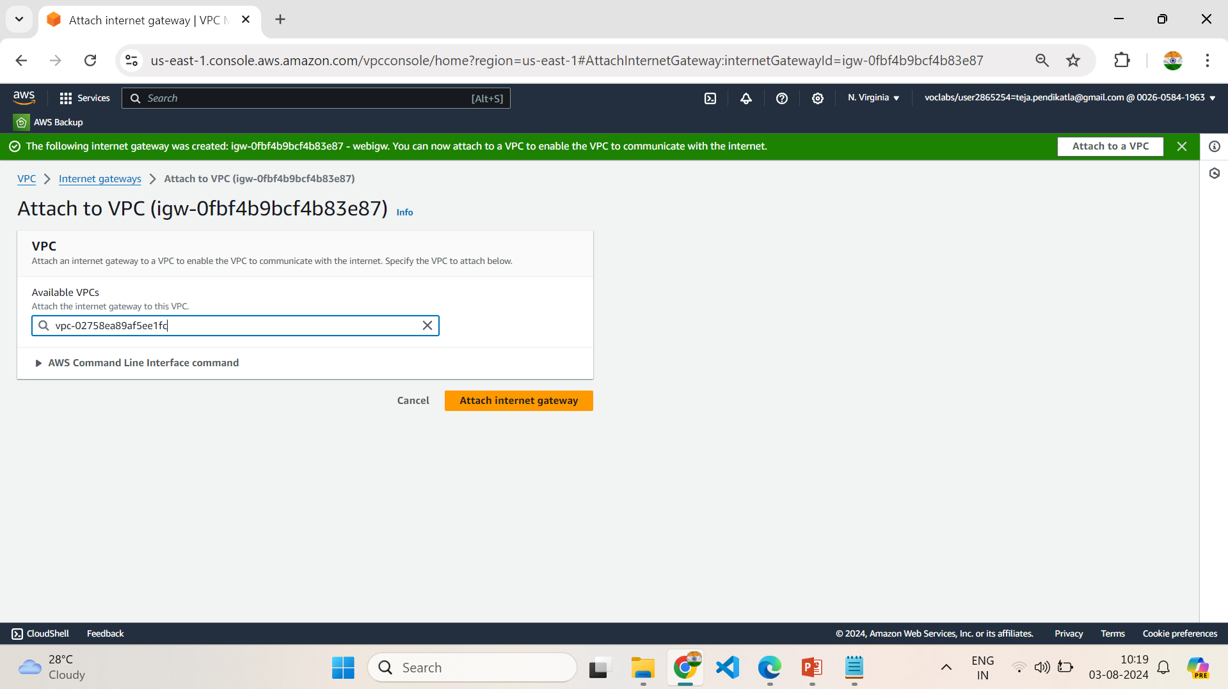
4.4 Select the created VPC and click on attach it to IGW

Slide 26
5.Setup Default Route table of VPC
1.While creating VPC , a default RouteTable is created, Each subnet in your VPC is associated with a route table which controls the traffic flow between subnets.
2.Give a name as webroute1 to the default created Routetable.
3.Select the default Route table - webroute1
4.Click on Routes ,Click on edit route and add route – Choose 0.0.0.0 in left dropdown & Choose Internet Gateway in Right dropdown and exactly down to it select created Internet Gateway.
5.Click on Save changes.
6.Click on Subnet Associations , Click on edit Subnet Associations & select the public subnet created under VPC and Click on save changes.
7.Now we successfully updated the Routes and Subnet Associations of Default Route Table

Slide 27
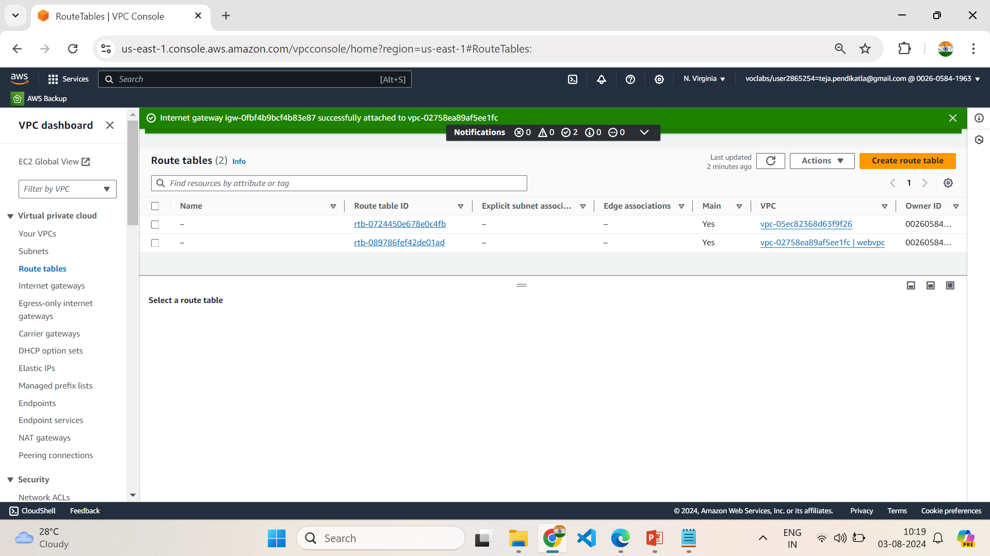
5.1 Click of Default Route Table & Change the name

Slide 28
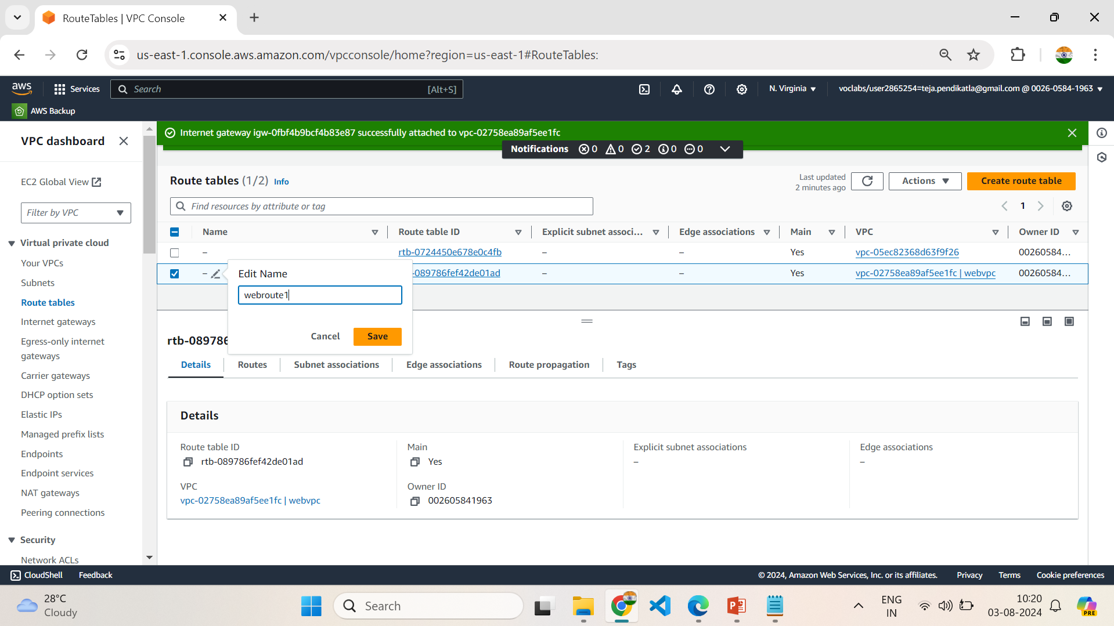
5.2 Save the new name to Default Route table

Slide 29
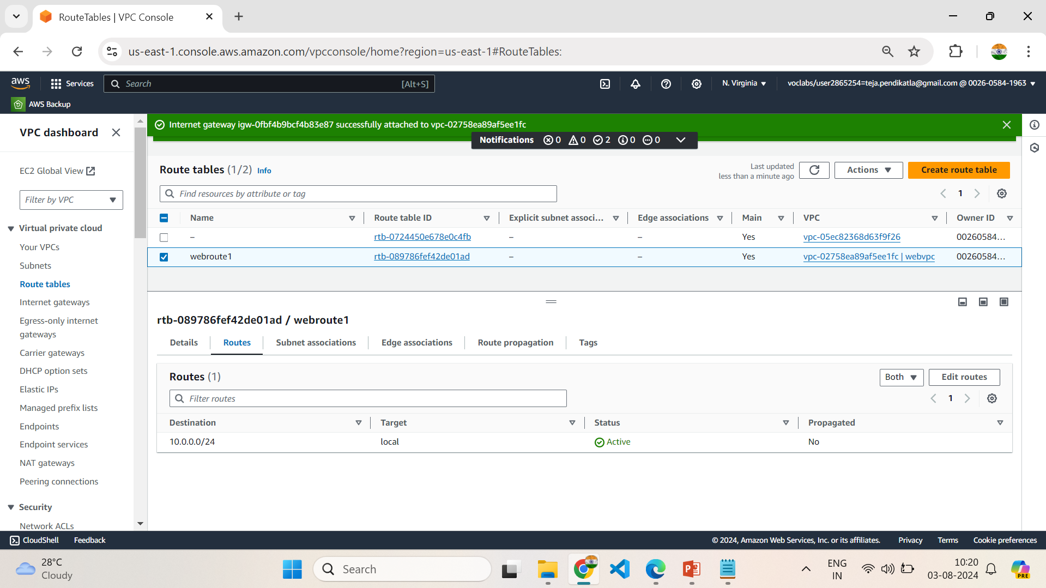
5.3 Select Default Route table & Click on Routes

Slide 30
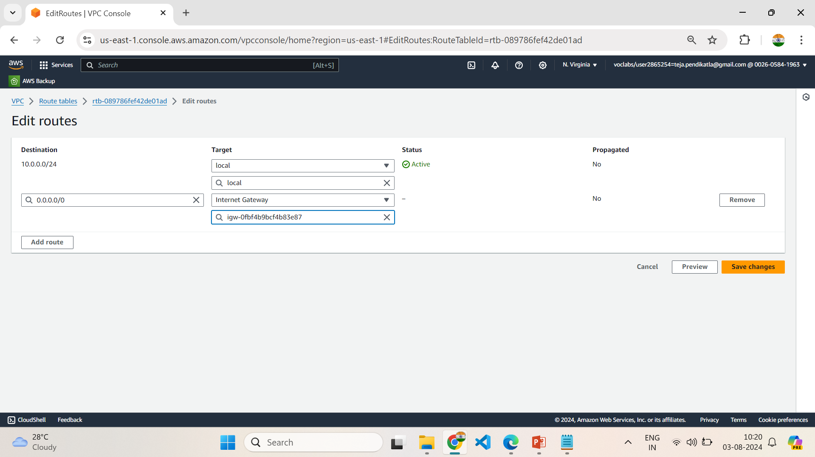
5.4 Follow the steps in Setup Default Route table of VPC

Slide 31
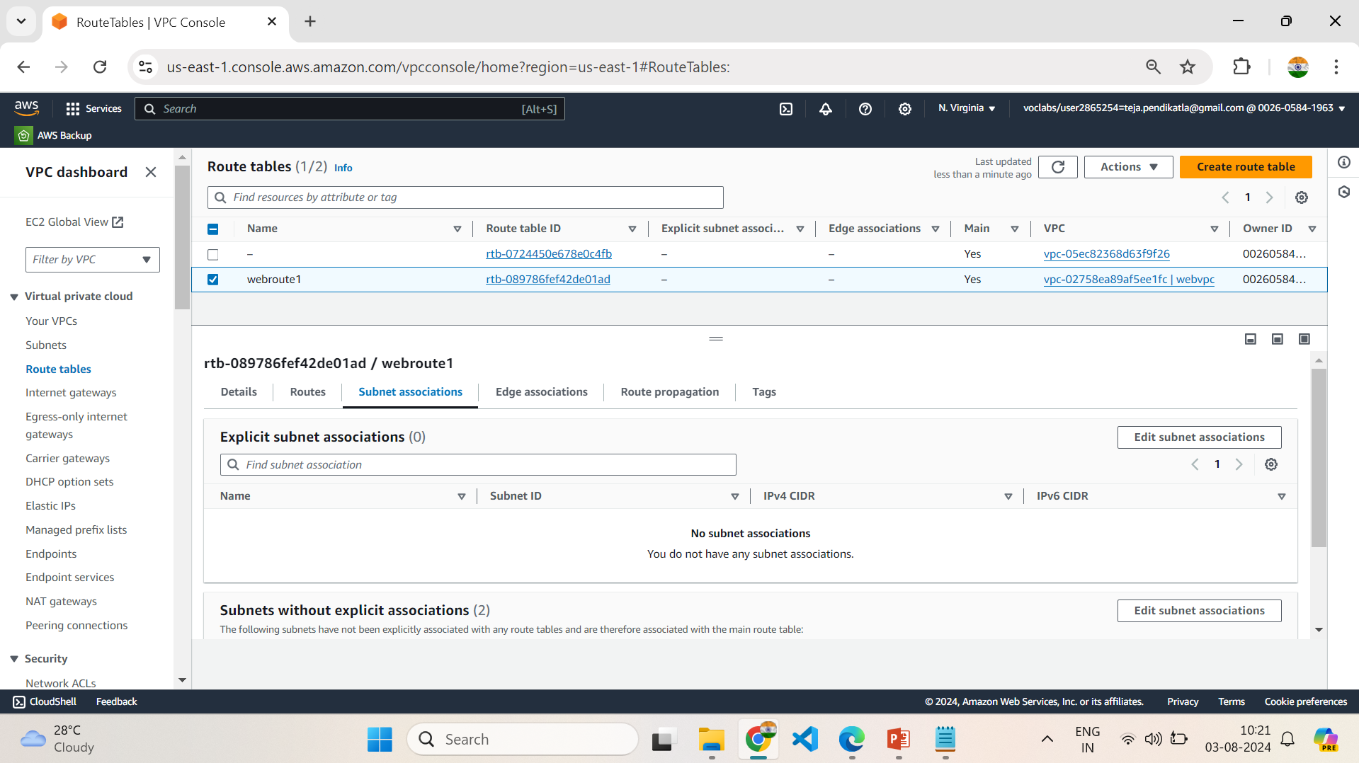
5.5 Select Default Route table & Click on Subnet Associations

Slide 32
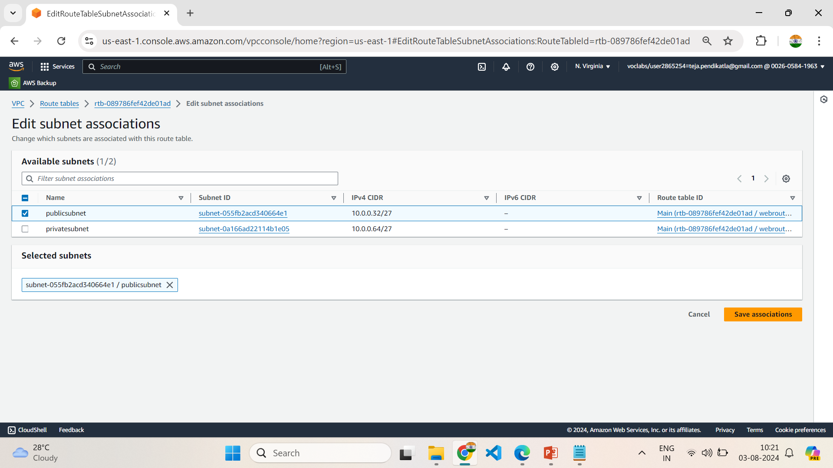
5.6 Follow the steps in Setup Default Route table of VPC

Slide 33
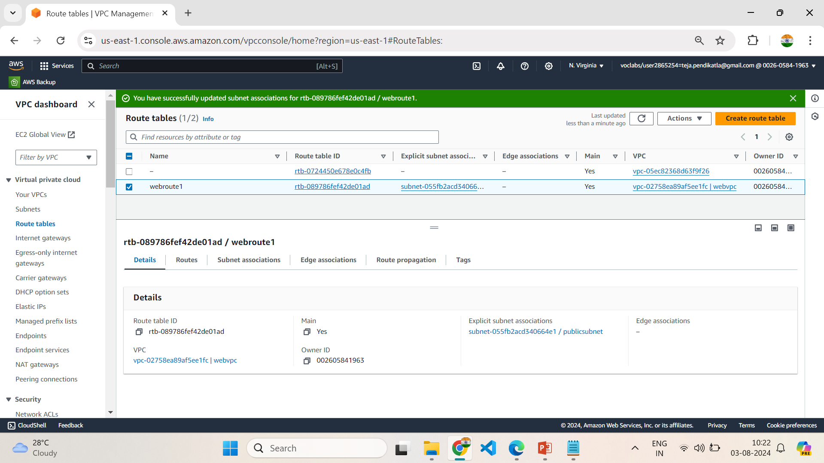
5.7 Successfully updated the setting of Default Route table

Slide 34
6.Setting up NAT Gateway
1.Open NAT Gateways in VPC Dashboard.
2.Click on Create an NAT Gateway , give name to the NAT Gateway as webnatgw
3.Select publicsubnet, & Click on Allocate Elastic IP in Elastic IP allocation ID.
4.Click on Create NAT Gateway.
5.Open Route table in VPC Dashboard, Create a new route table with name as webroute2.
6.Select the created VPC & Create Route Table.
7.Select the newly created Route Table , Click on Routes.
8.Click on edit route and add route – Choose 0.0.0.0 in left dropdown & Choose NAT Gateway in Right dropdown and exactly down to it select created NAT Gateway.
9.Click on Save changes.
10.Click on Subnet Associations , Click on edit Subnet Associations & select the privatesubnet created under VPC and Click on save changes.
11.Now we successfully updated the Routes and Subnet Associations of Default Route Table

Slide 35
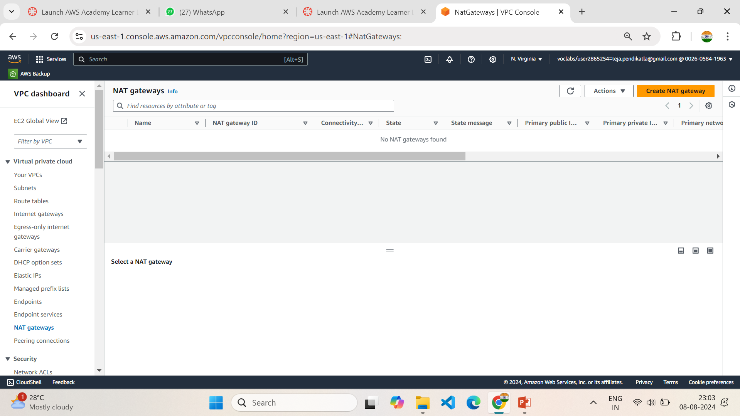
6.1 Create a NAT Gateway

Slide 36
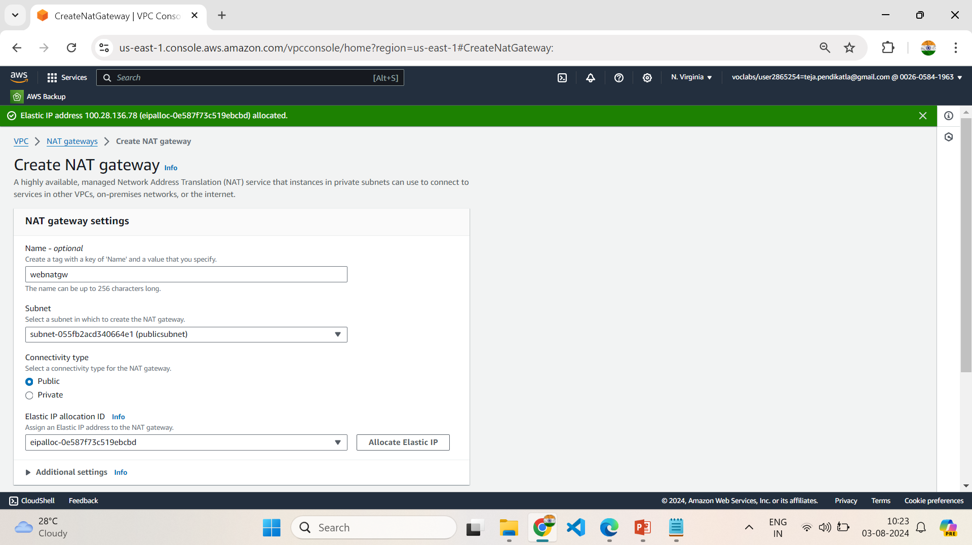
6.2 Select Public Subnet & click on Allocate Elastic IP

Slide 37
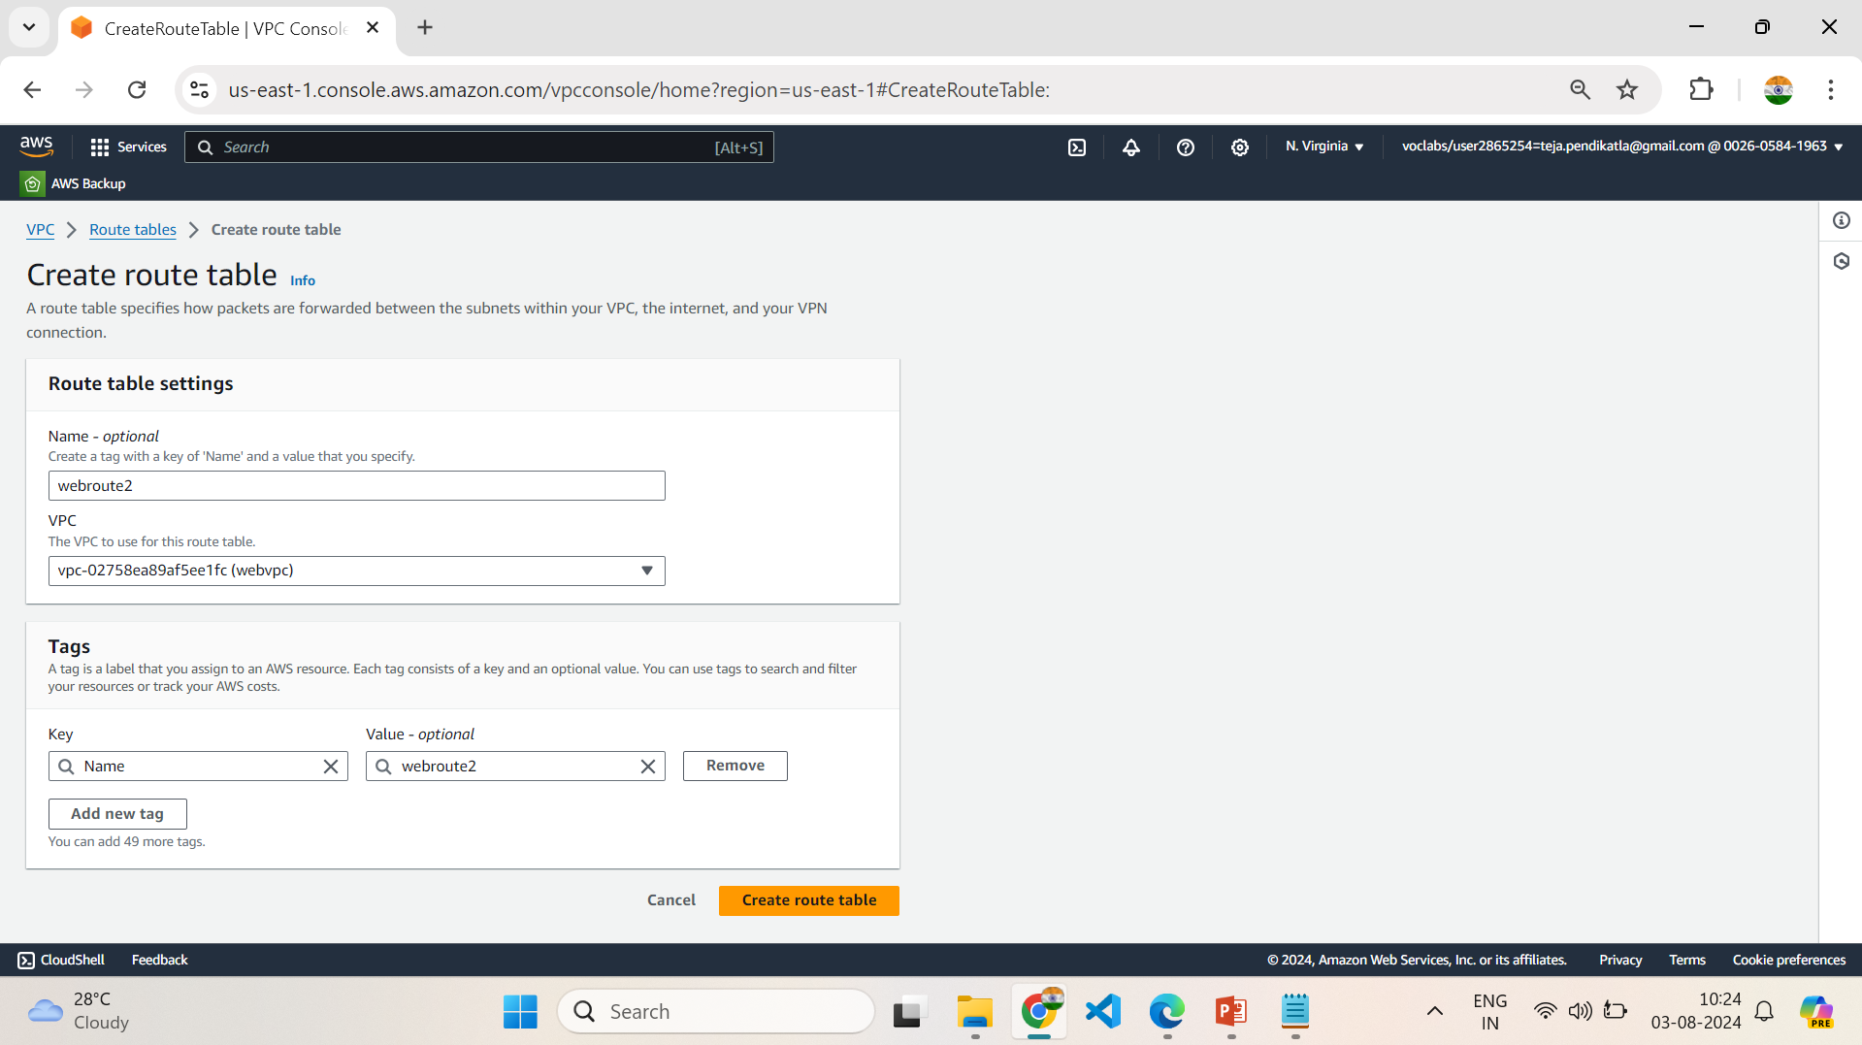
6.3 Create a new Route table

Slide 38
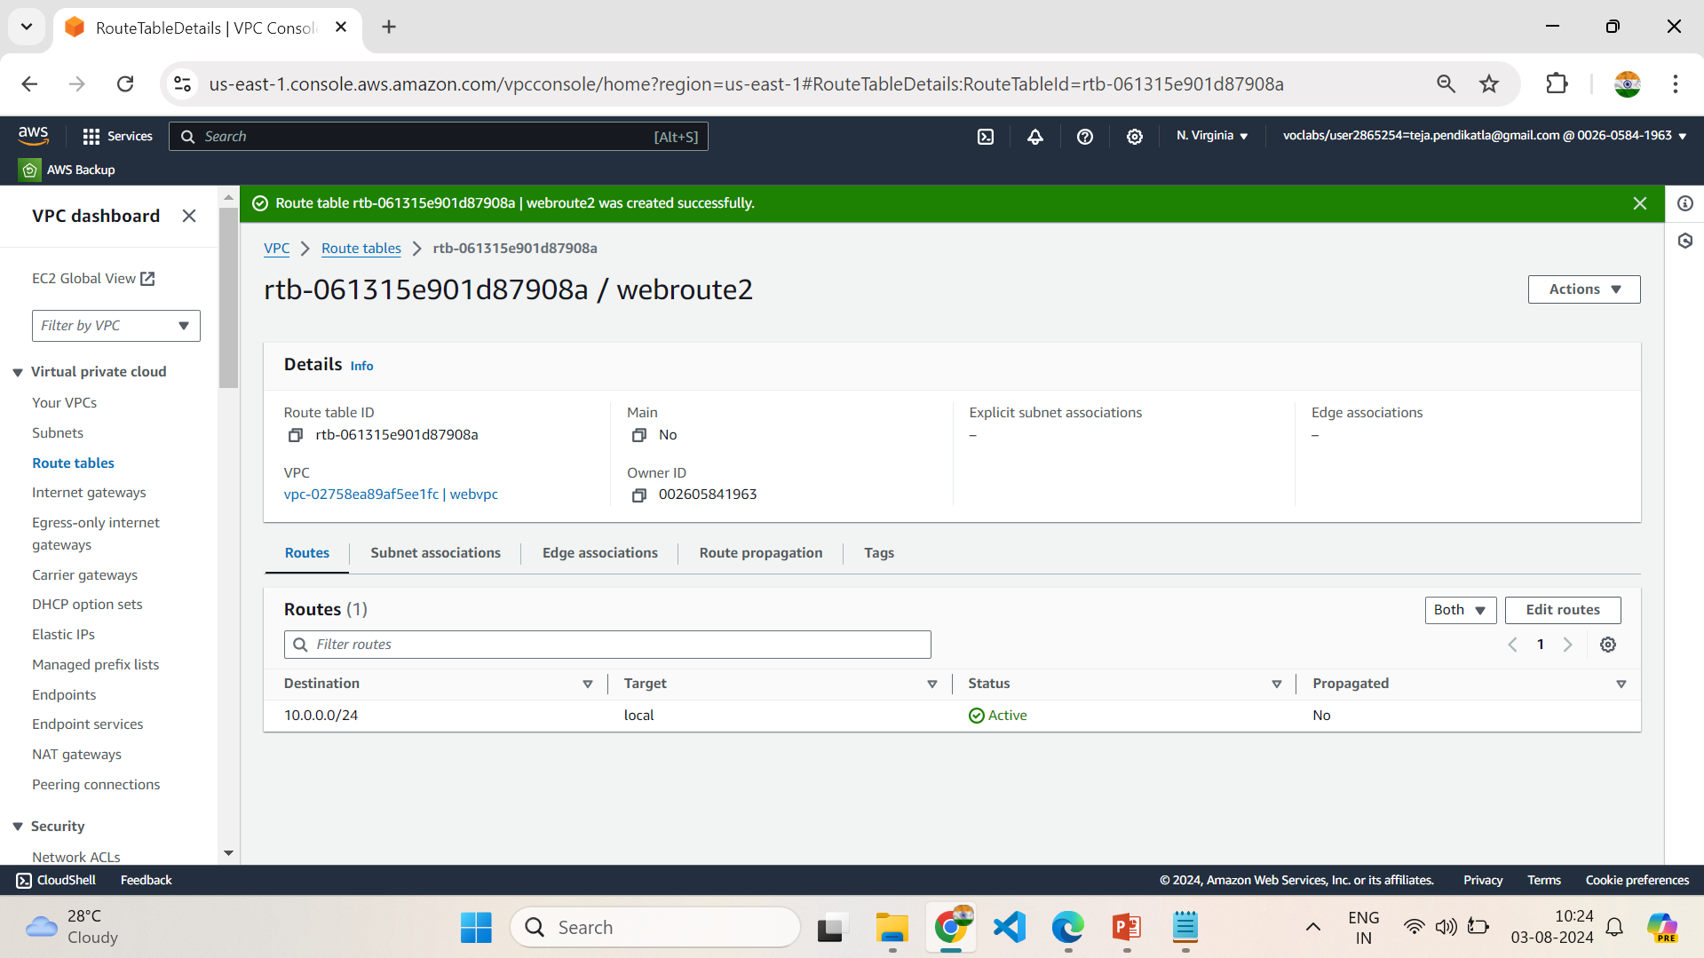
6.4 Click on Routes & Follow Setting up NAT Gateway

Slide 39
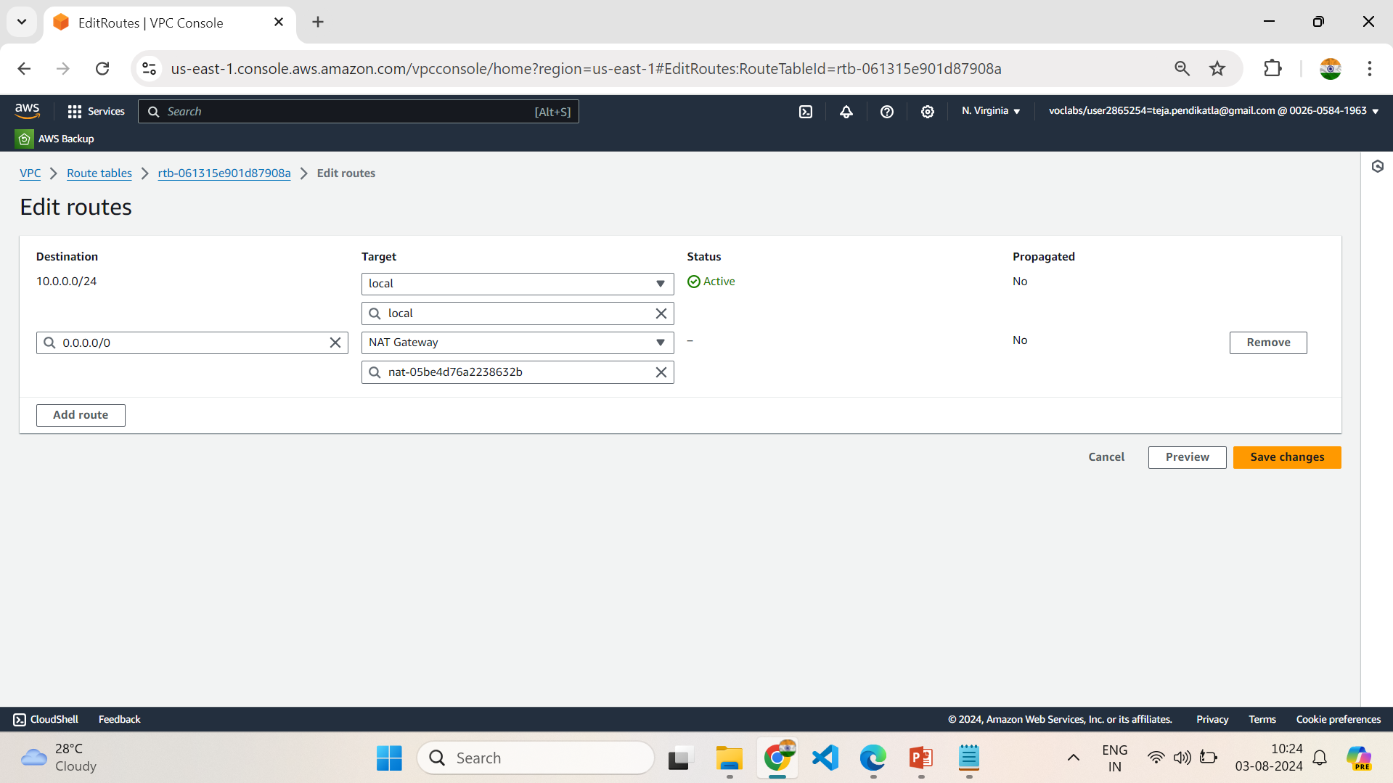
6.5 Follow the steps in Setting up NAT Gateway

Slide 40
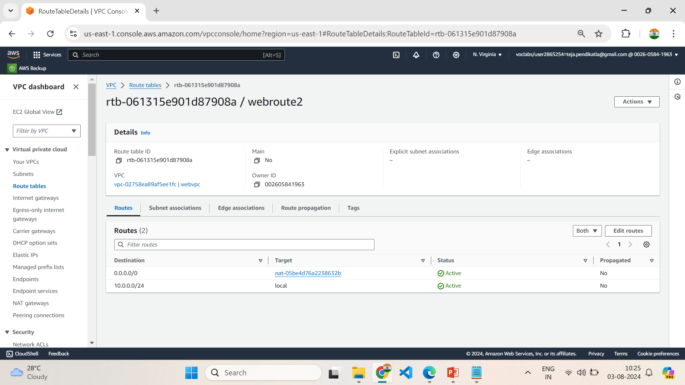
6.6 Routes updates Successfully in webroute2

Slide 41
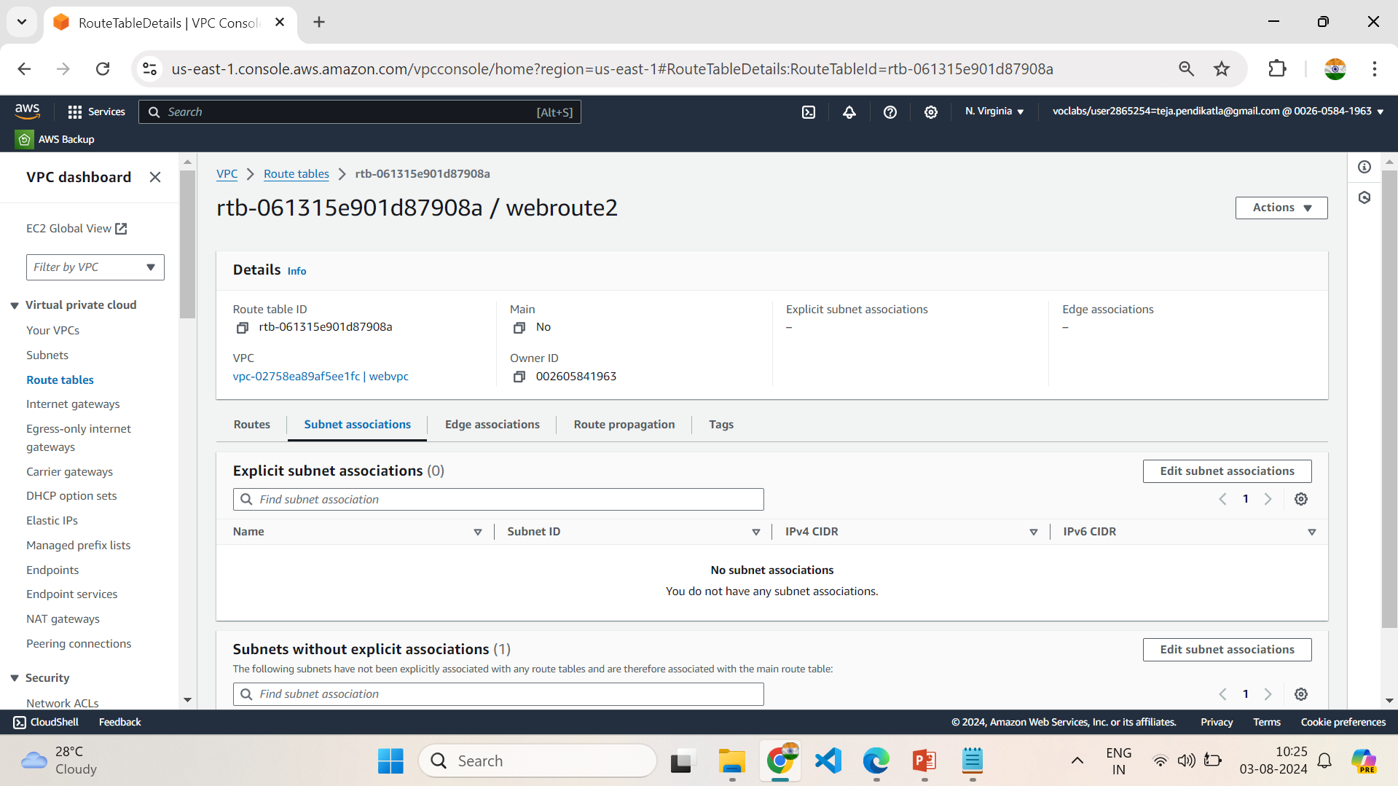
6.7 Click on Subnet Associations & Follow Setting up NAT Gateway

Slide 42
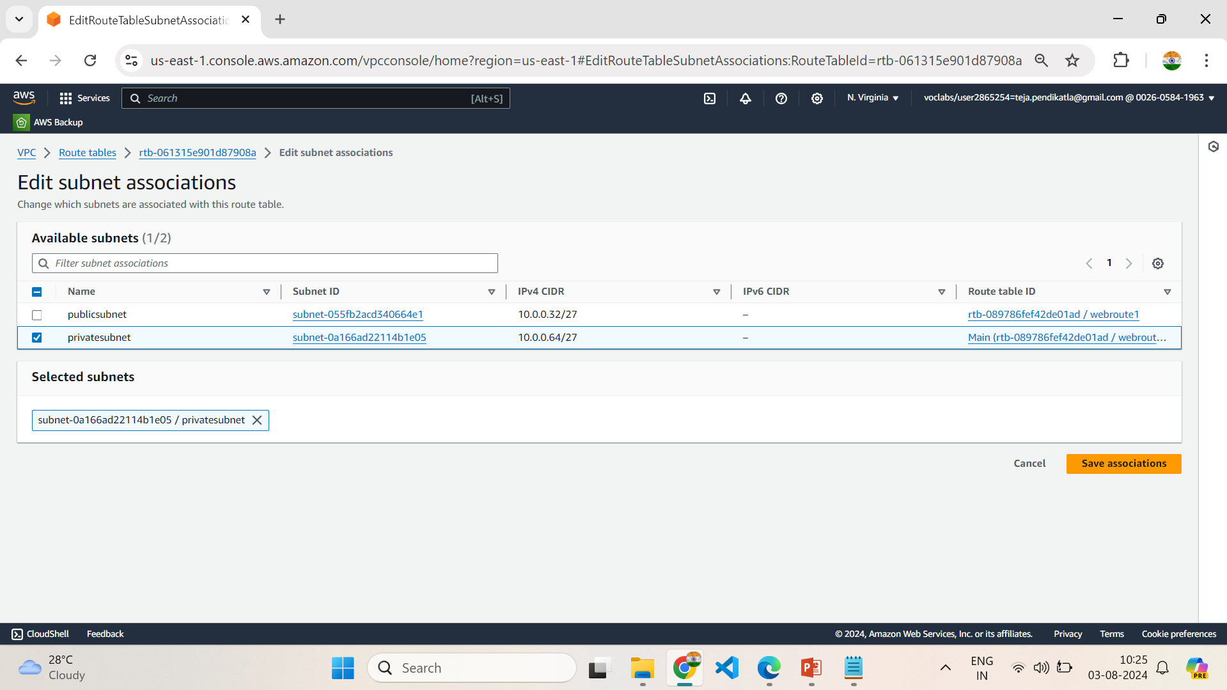
6.8 Select the Subnet & save changes

Slide 43
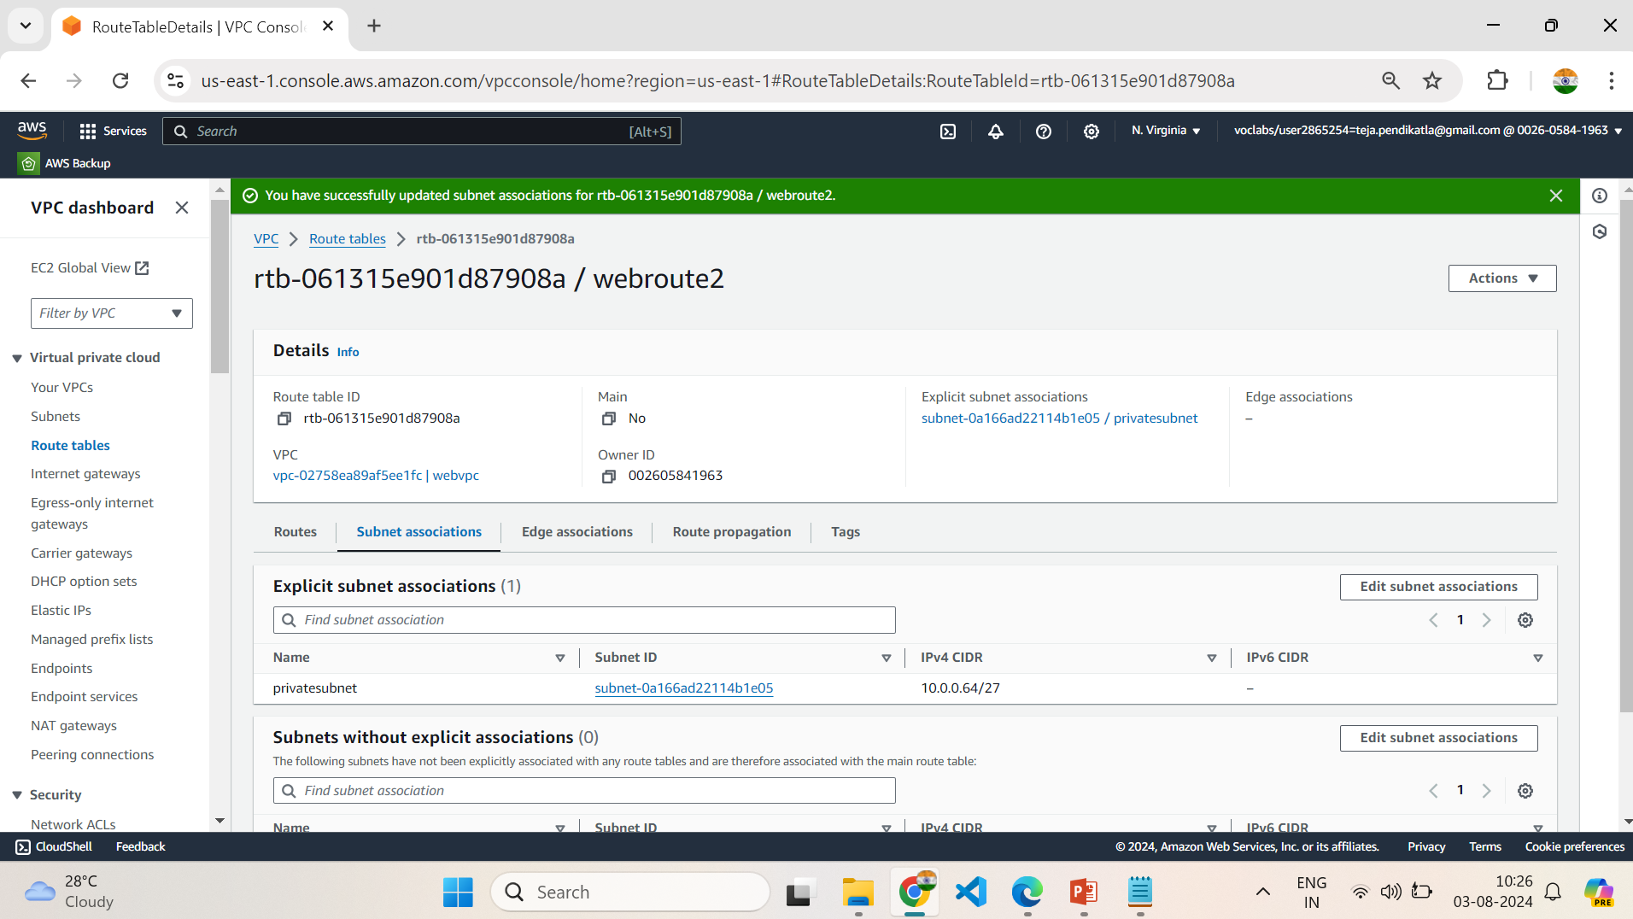
6.9 Subnet Associations updates Successfully in webroute2

Slide 44
7.Launch Template
1.Search for EC2 in the AWS Management Console & open EC2 Dashboard
2.Click on Launch Template , give a name to template as webtemp and version description as websitetemplate.
3.Click on Quick start & Select an AMI(Amazon Machine Image) based on requirement of the task , Our requirement is Microsoft Windows Server 2022 Base.
4.Choose the type of instance in Instance Type based on requirement Our requirement is t2.micro
5.Select an existing key pair or create a new Key pair : Vockey (Already created Key-pair)
6.Choose the VPC and subnet, where you want your instances to be launched in Network settings.
7.Select created VPC (webvpc) & select the publicsubnet in Subnet.
8. Review your settings and click on Create launch template.

Slide 45
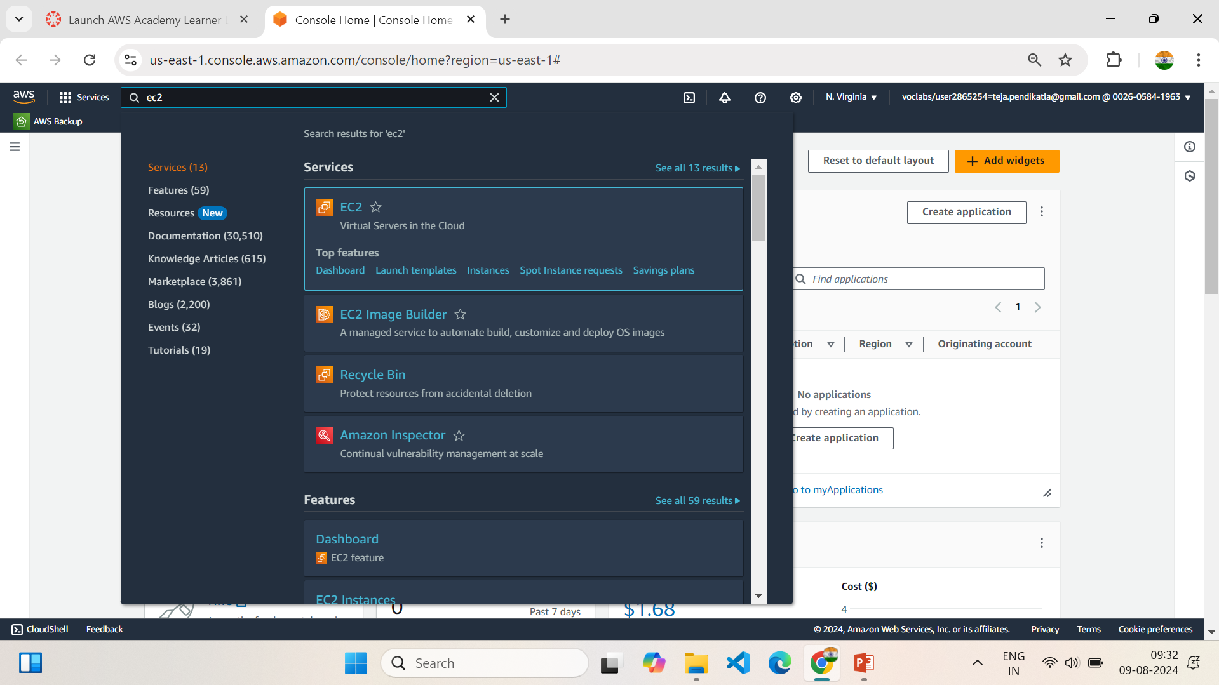
7.1 Search for EC2 Services in AWS Console Home

Slide 46
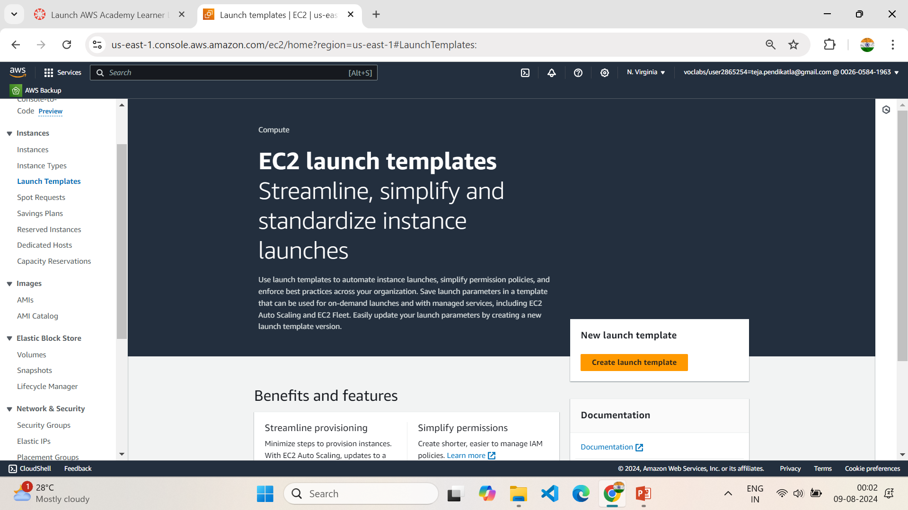
7.2 Create a new template

Slide 47
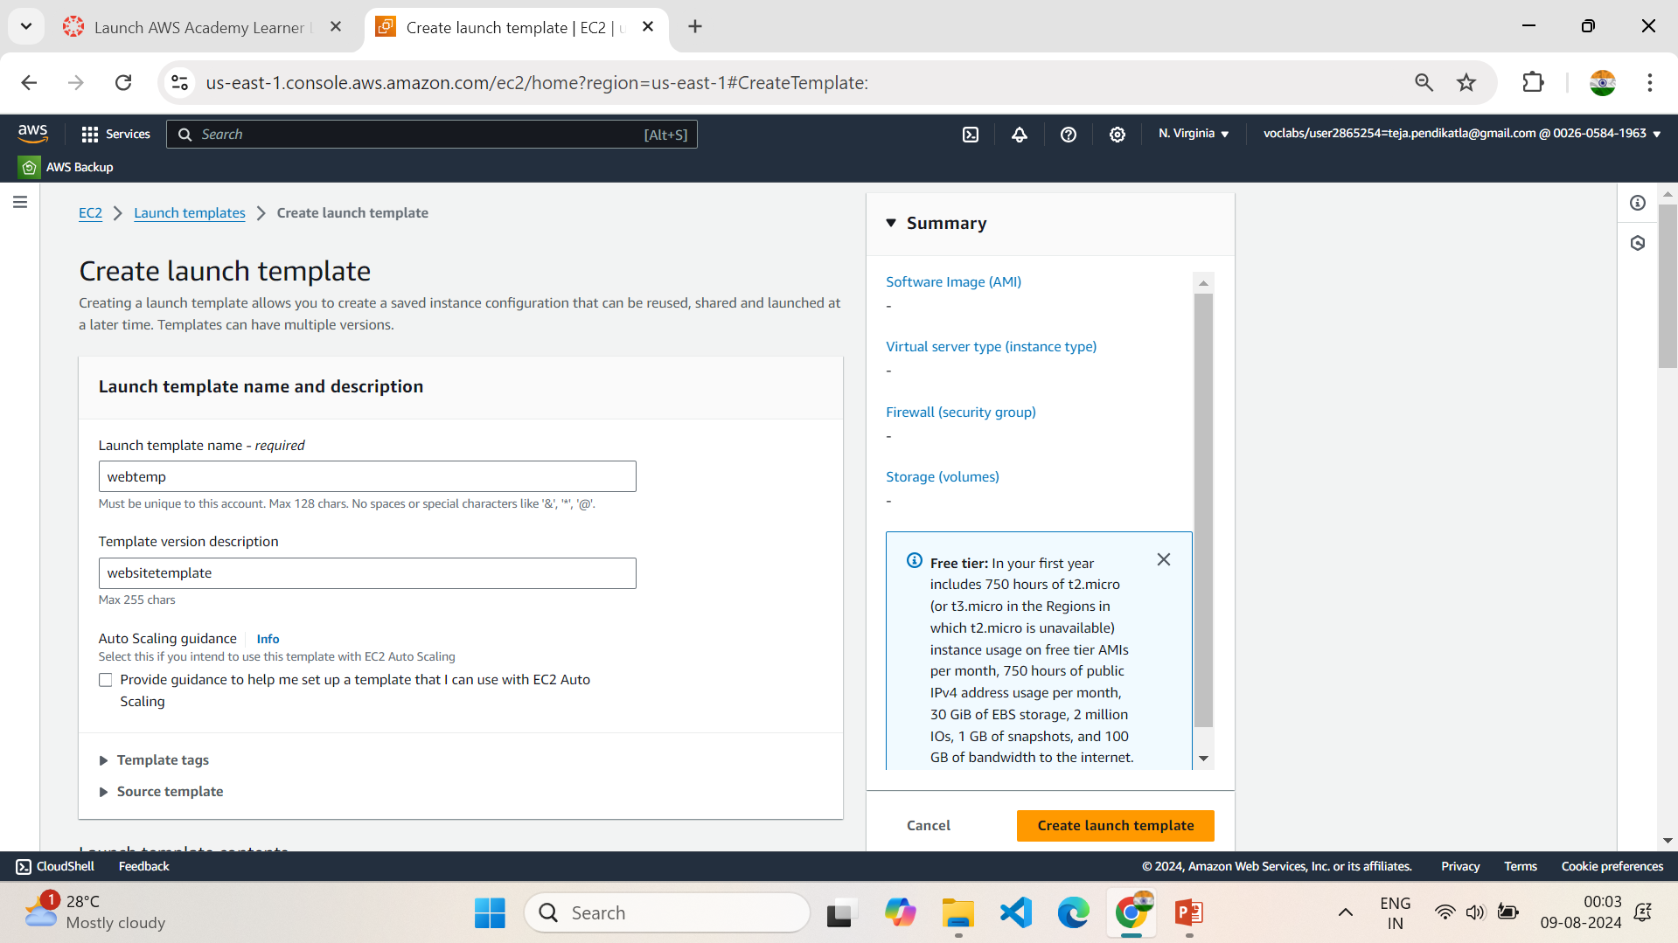
7.3 Give the Name and description of template

Slide 48
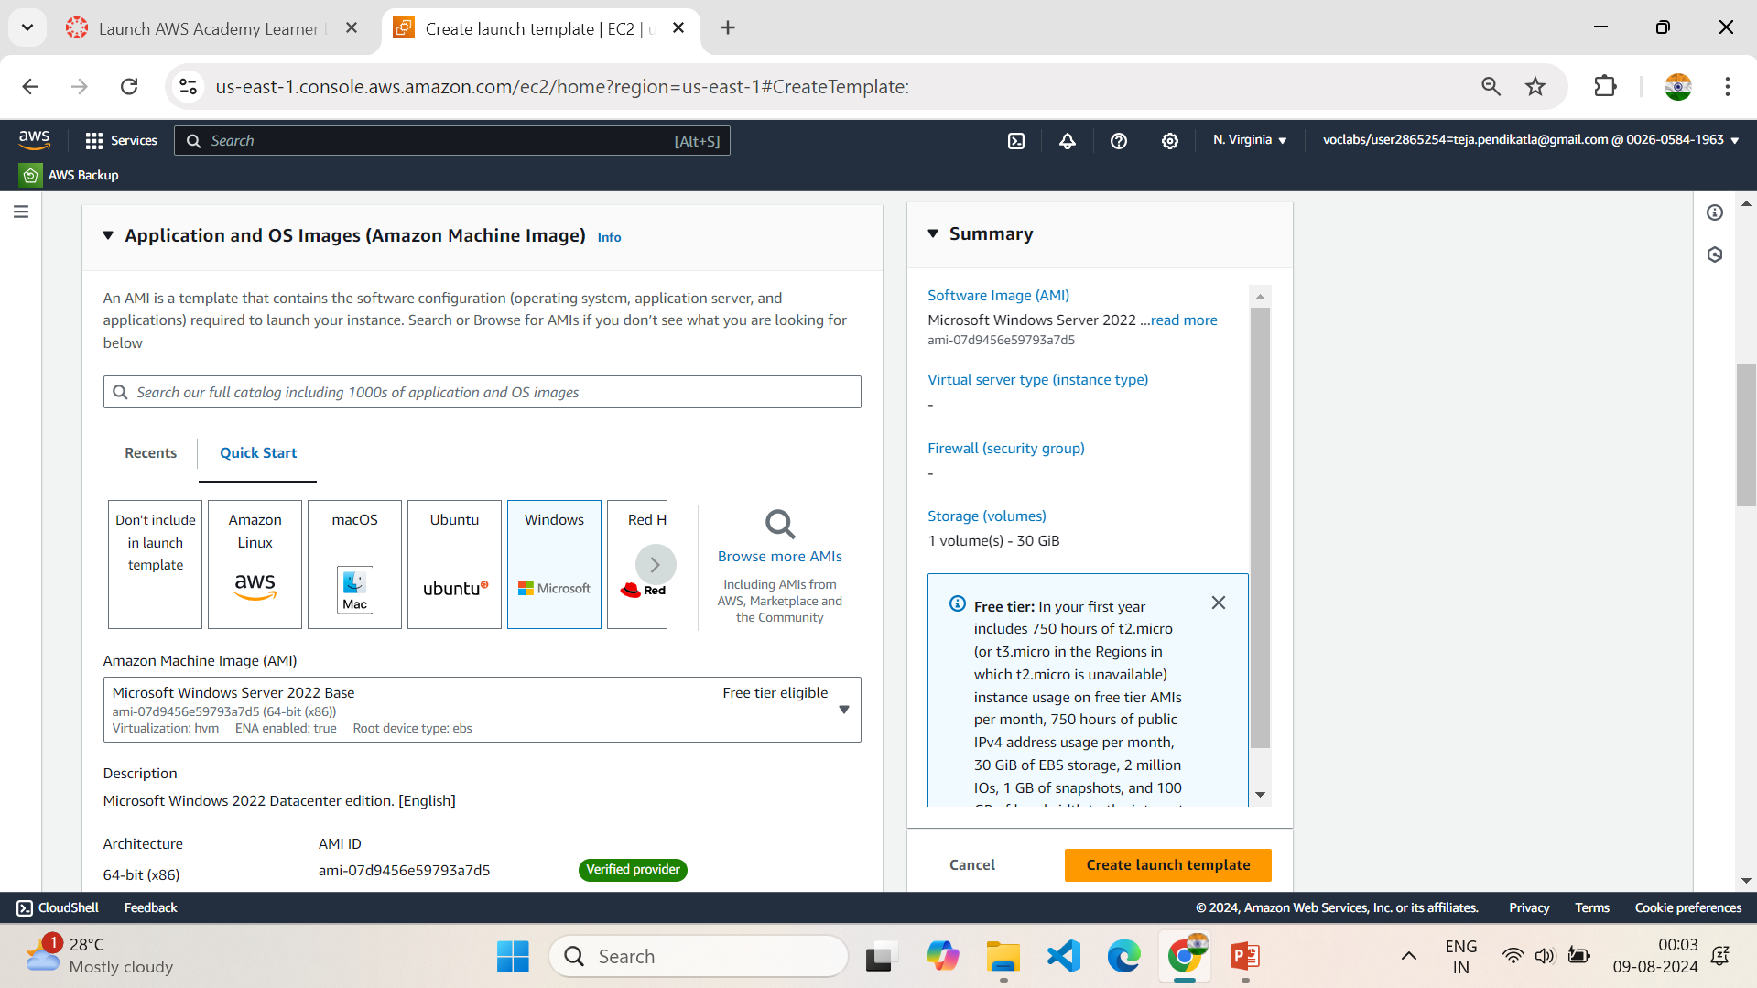
7.4 Choose Amazon Machine Image

Slide 49
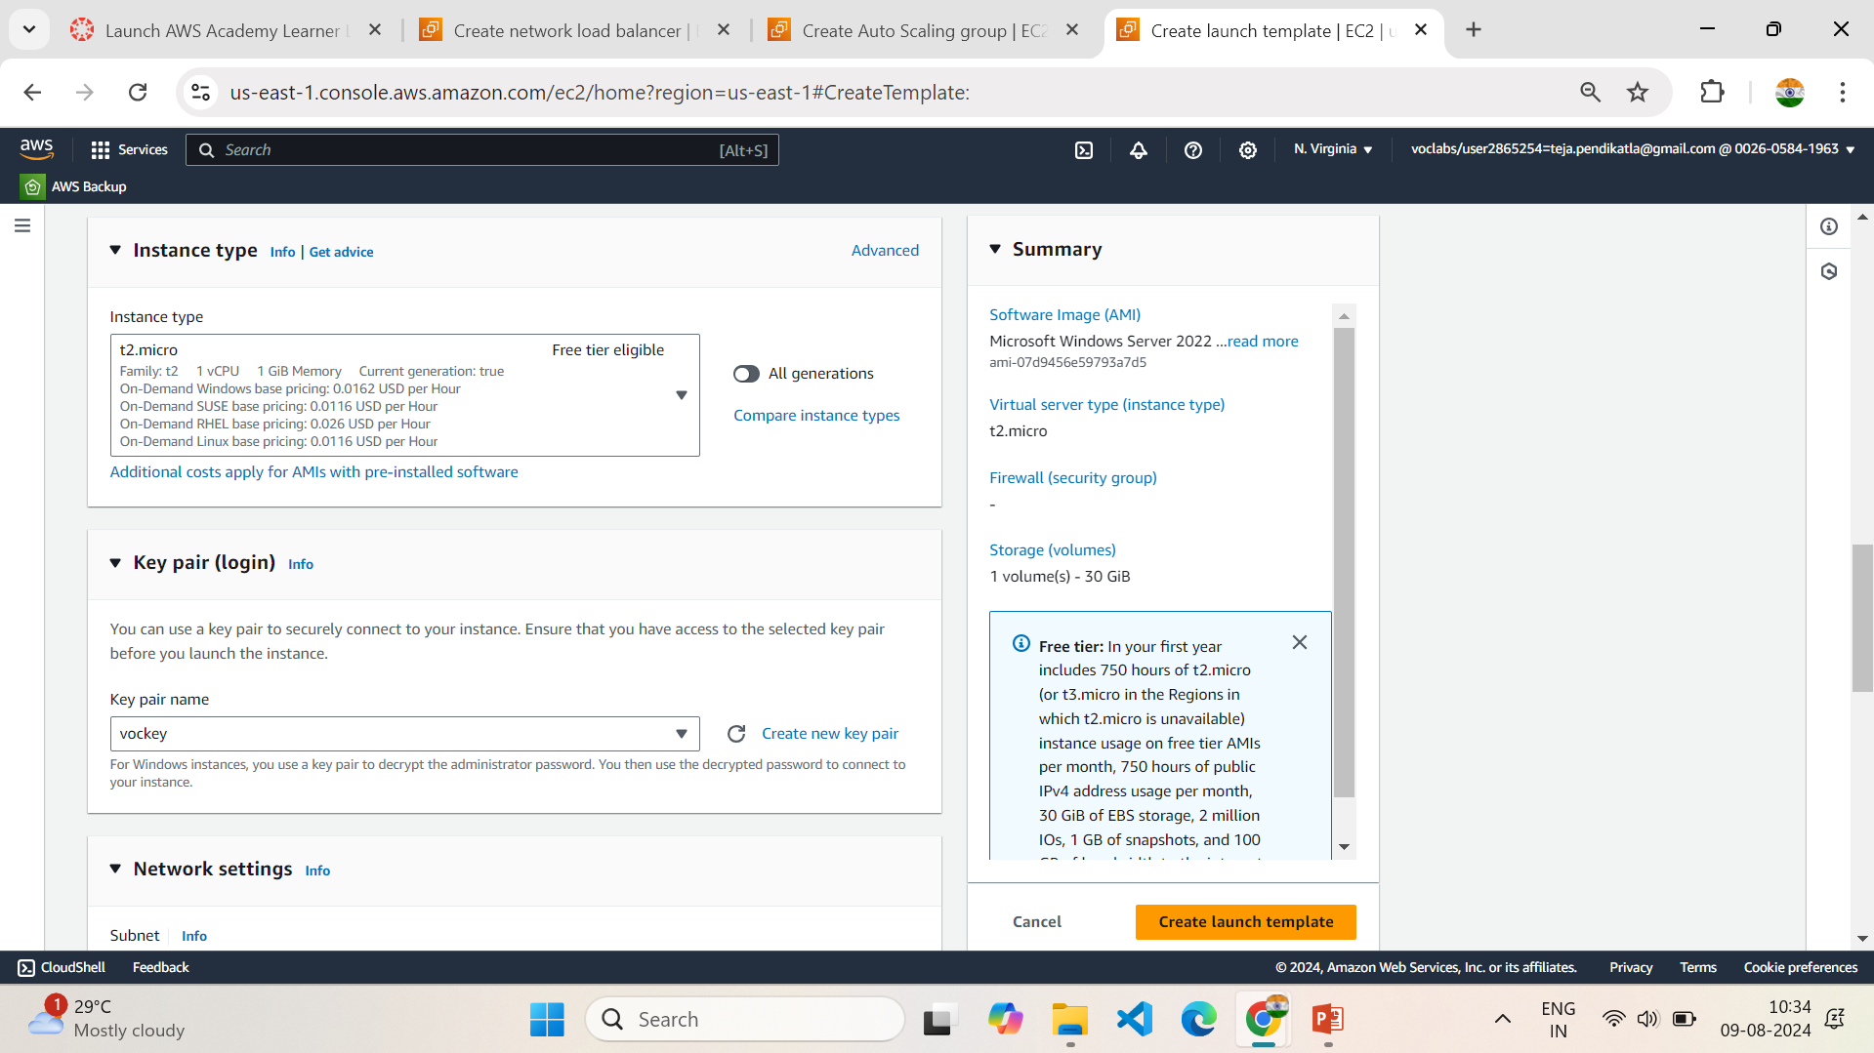
7.5 Choose Instance type Based on requirement

Slide 50
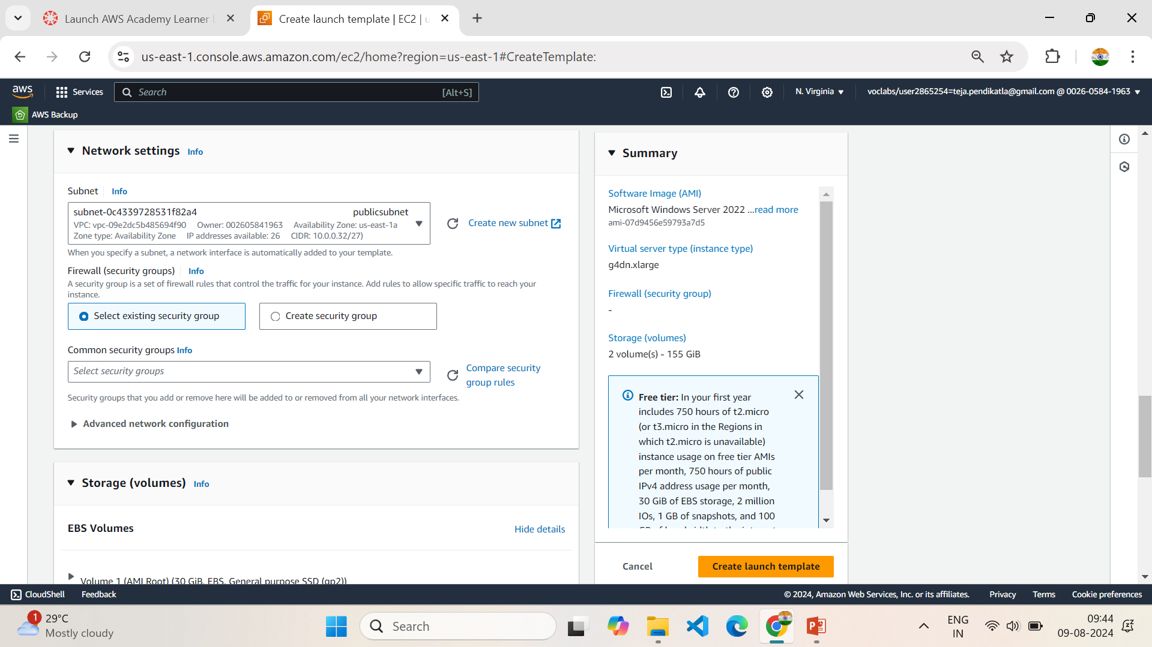
7.6 Select Created Subnet

Slide 51
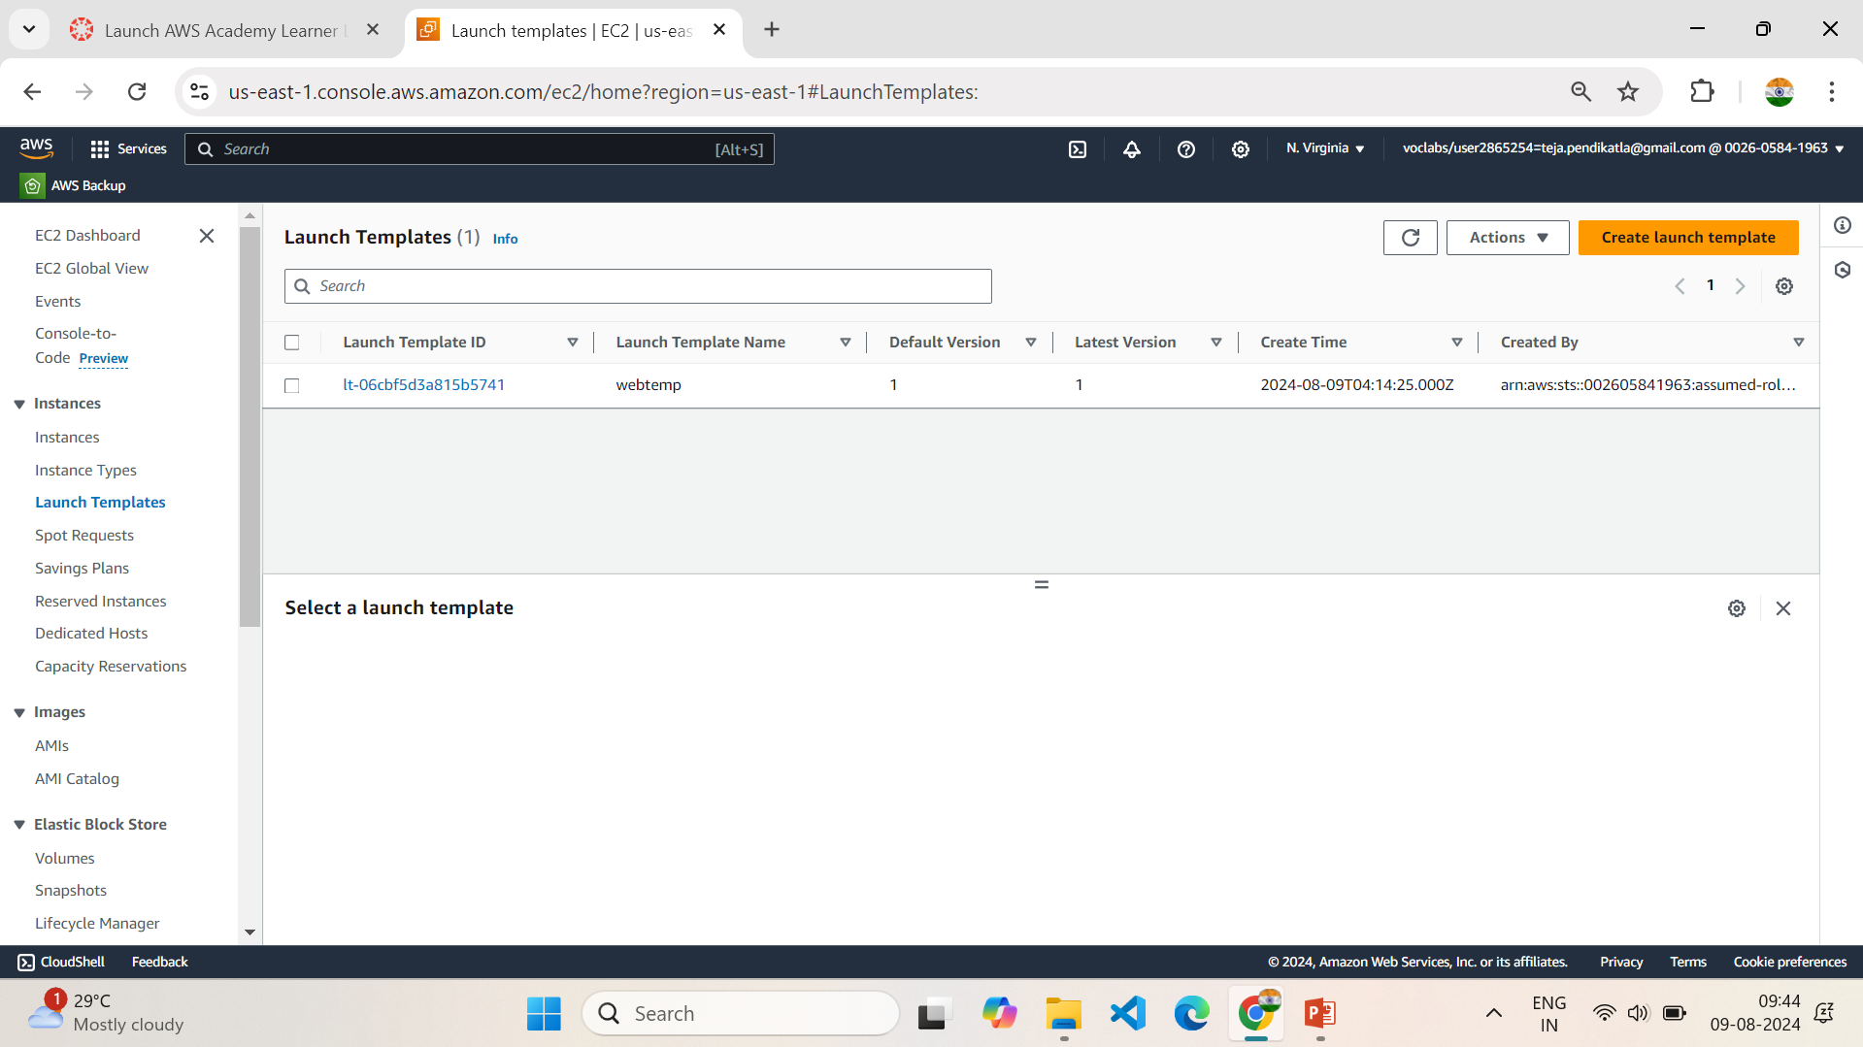
7.7 Template is Created

Slide 52
8.Setting Up Load Balancer
1.In the EC2 Dashboard, Click on Load Balancing in the left sidebar.
2.Click on Create Load Balancer & Choose the type of load balancer Based on requirement,
Our Requirement is : Network Load Balancer (NLB) for high performance and low latency.
3.Give a name for your load balancer as “webloadbalancer” & Select the VPC (webvpc) ,Checkmark the availability zones for which your are creating Load Balancer.
4.In Listeners and routings , Choose TCP & Select existing Target Groups or Create a new Target Groups, We are creating a new target group so Click on Create new Target Group.
5.Choose target type - select Instances in Basic Configuration, Give Name to Target Group , Choose Protocol : Port -TCP : 80 as per our requirement & Choose the VPC (webvpc)
6.Health Checks: Choose TCP in Health Check Protocol, Click on Next & Create Target Group.
7.In Listeners and routing Select the created Target Group, click on next .
8.Review all Settings and Click Create Load Balancer.

Slide 53
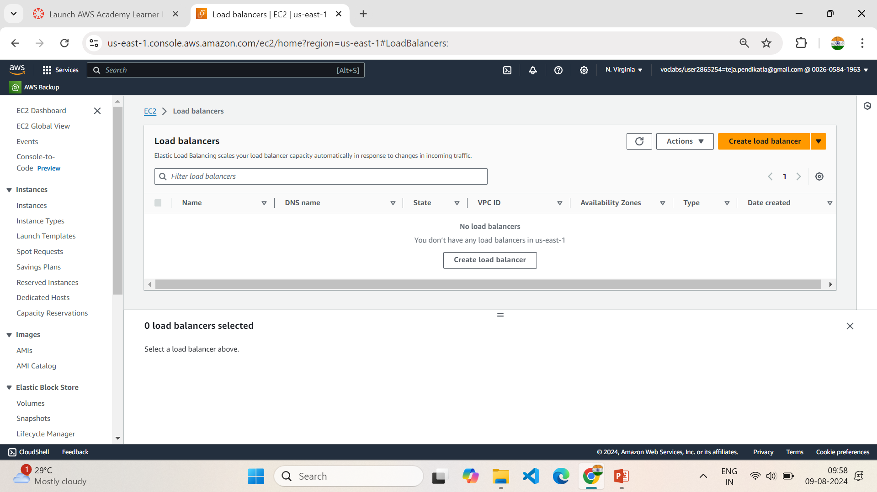
8.1 Create a Load Balancer

Slide 54
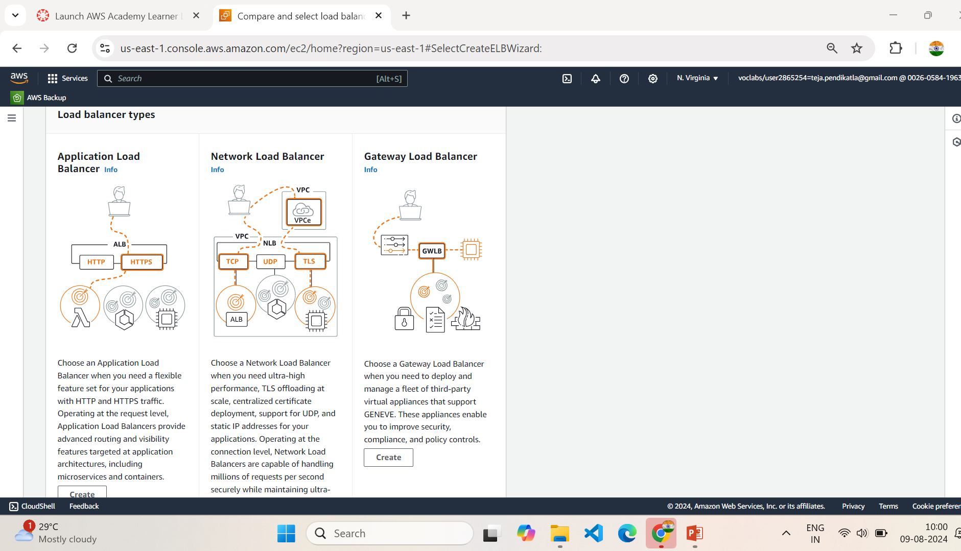
8.2 Select Load balancer Types

Slide 55
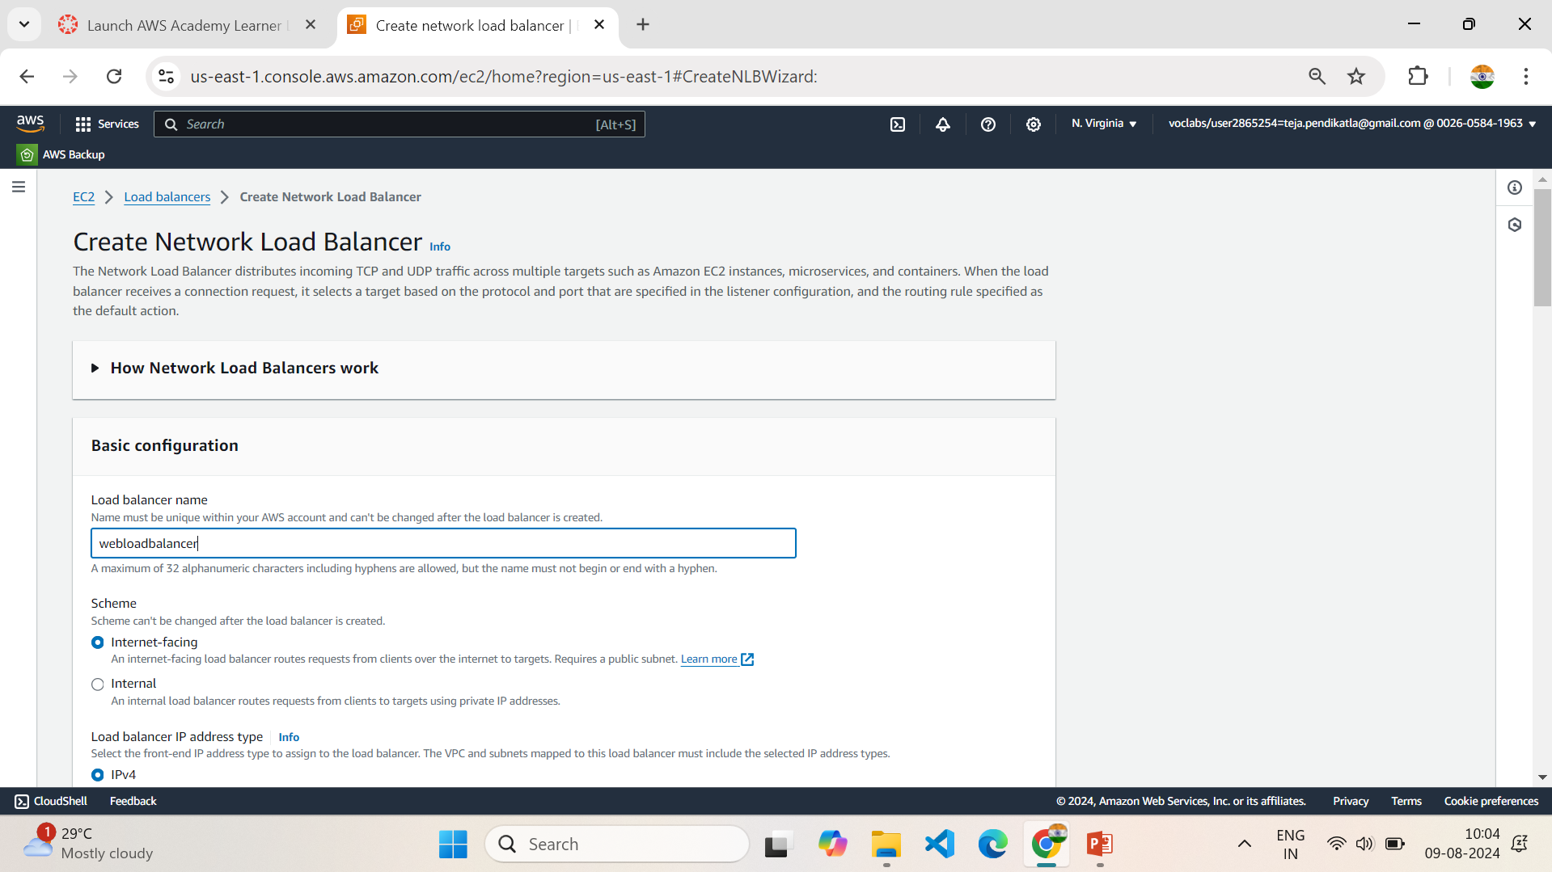
8.3 Give name to Load Balancer

Slide 56
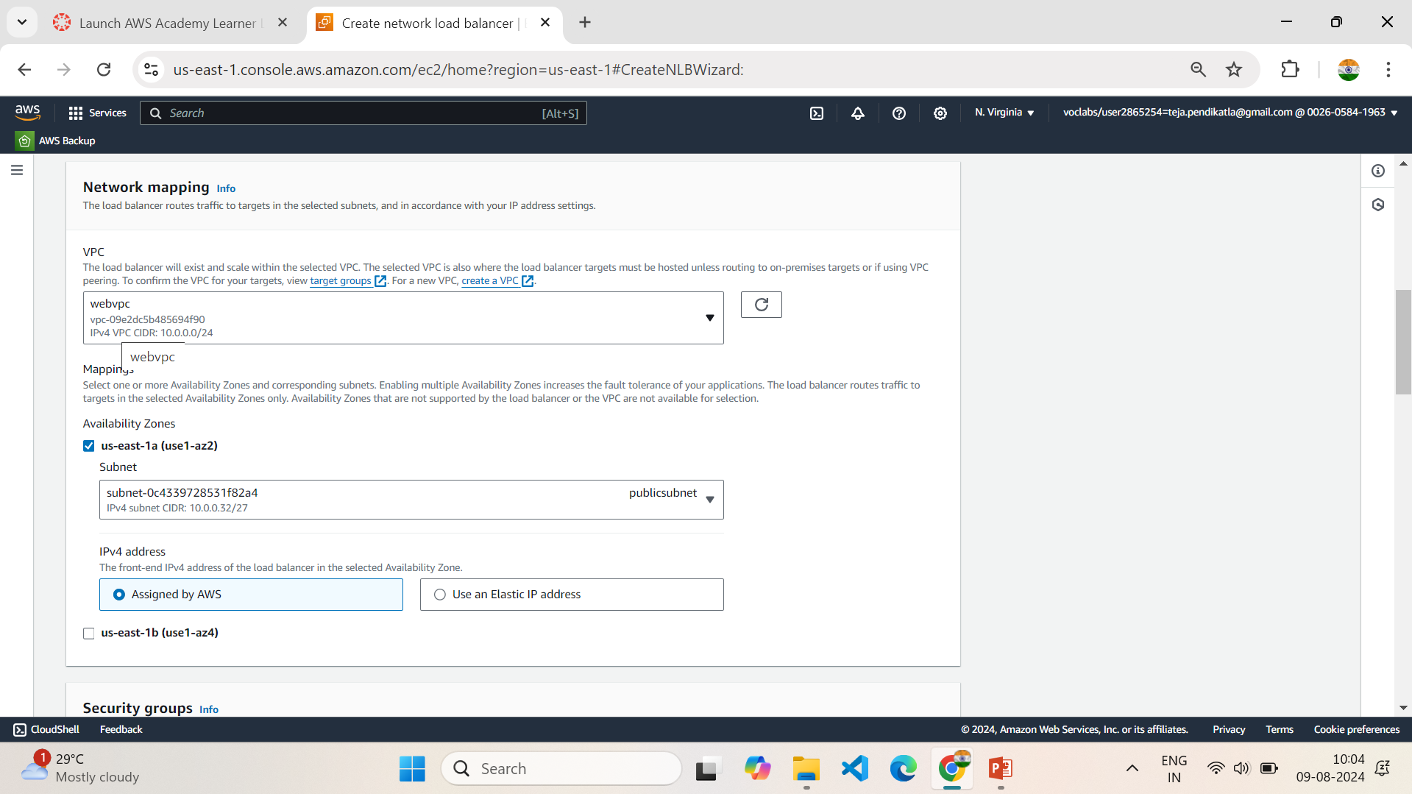
8.4 Select VPC & Availability Zone

Slide 57
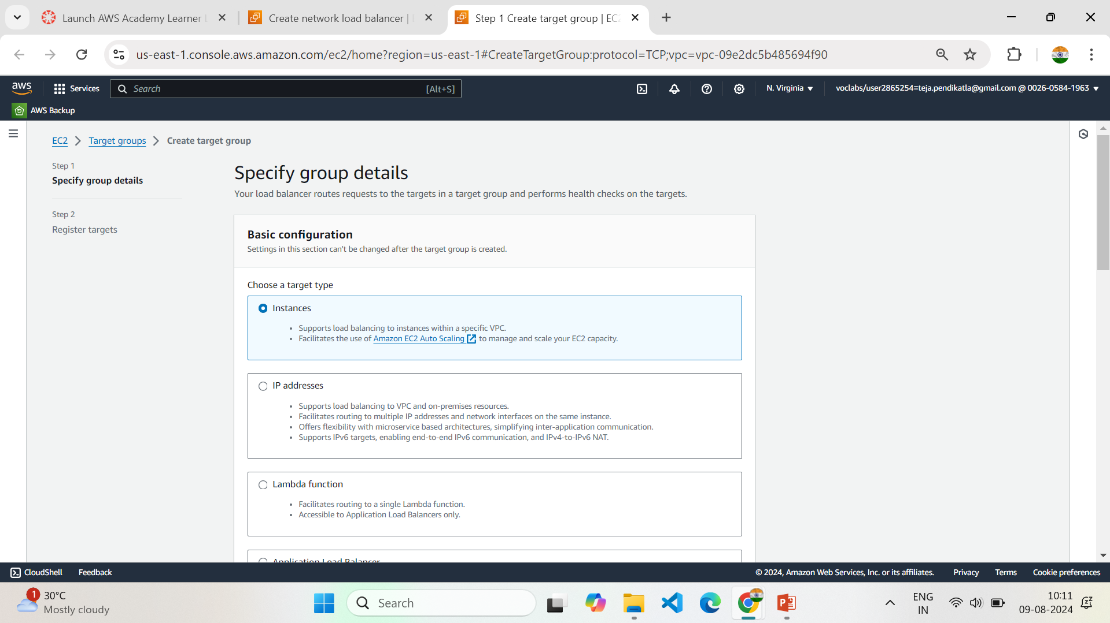
8.5 Create New Target Group, Follow Setting Up Load Balancer

Slide 58
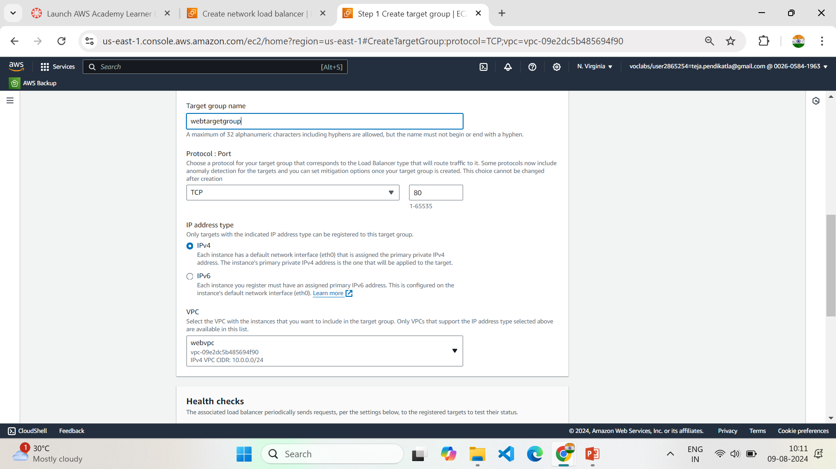
8.6 Give name & select created VPC

Slide 59
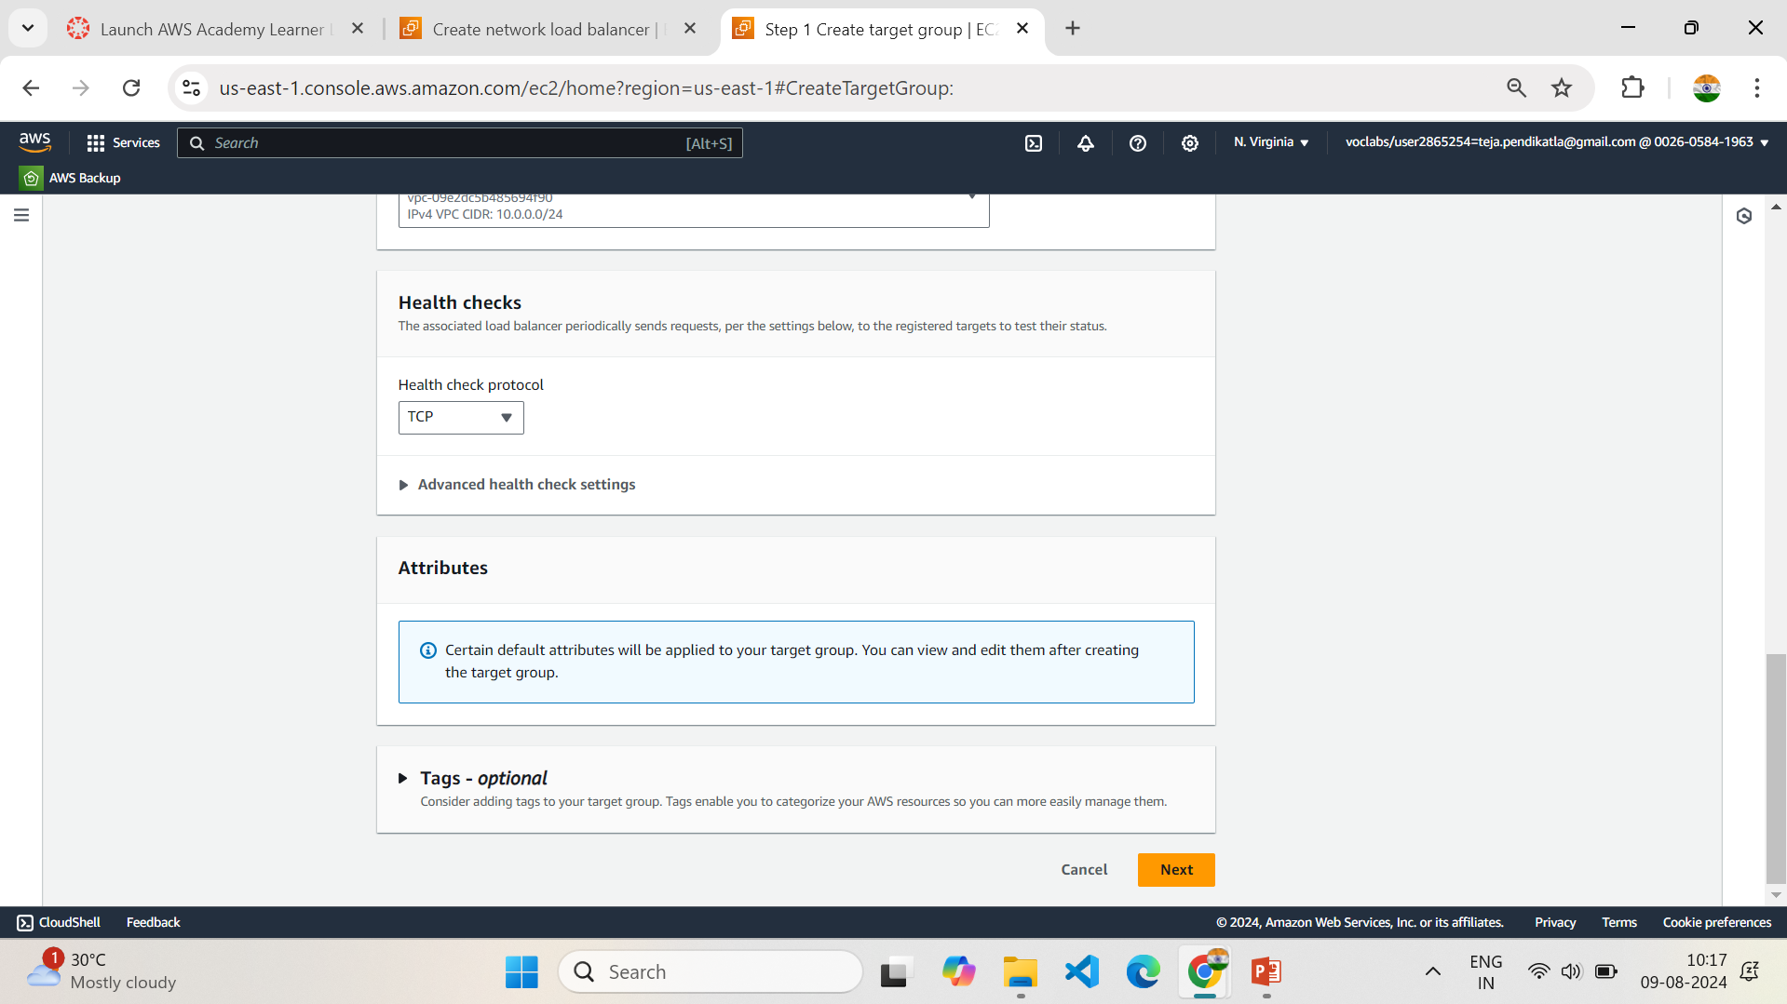
8.7 Select Health check protocol

Slide 60
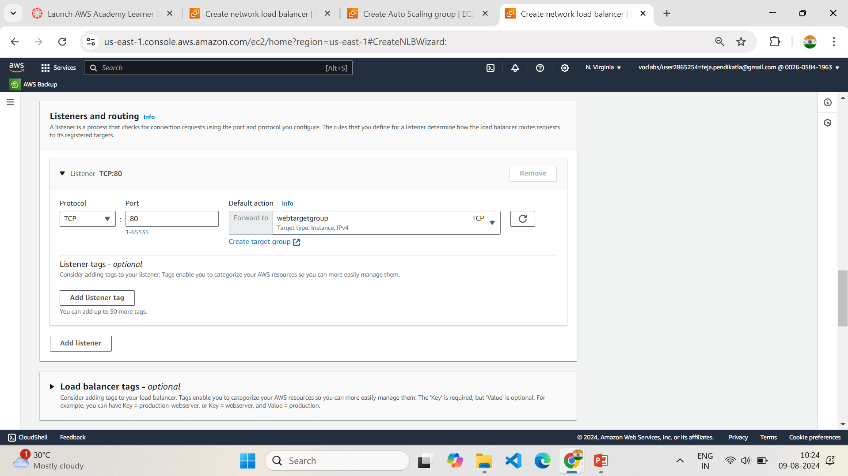
8.8 Select Newly created Target group in Load Balancer

Slide 61

8.9 Check the Summary of Load Balancer

Slide 62

8.10 Load Balancer is Created

Slide 63
9.Setting Up Auto Scaling Groups
1.Click on Create Auto Scaling Group, Give name to the Auto Scaling Groups ,Choose the version of the Template
2.Choose VPC & Availability Zone and Subnets in Network.
3.Select Attach to existing Load Balancer in Load Balancer type & select the existing Target Group.
4.Select the following options in 9.5.
5.Set the Health Check Grace Period in Health Checks as 120 seconds
6.Enter Desired Capacity (Number of Instance required in VPC) in Group Size.
7.Minimum Capacity (Set the minimum number of instances -1)
& Maximum Capacity (Set the maximum number of instances - 10).
8. Select the Following Options in 9.8 & Create Auto Scaling Group
9.Requried Instances are created based on template settings.

Slide 64

9.1 Create a Auto Scaling Group

Slide 65

9.2 Select template and Version

Slide 66

9.3 Choose VPC & Subnets

Slide 67

9.4 Select the Load Balancing type

Slide 68

9.5 Select the Target Group

Slide 69

9.6 Set the Health Check Grace Period

Slide 70

9.7 Enter Number of instances required in Desired Capacity

Slide 71

9.8 Select the Following Options & Create Auto Scaling Group

Slide 72

9.9 Auto Scaling Groups is Created

Slide 73

9.10 Required Instances are created

Slide 74

9.11 These 4 instances are targeted by Load Balancer

Slide 75
10.Setting up S3 bucket
1.Open AWS dashboard in AWS Management Console.
2.Search for S3 in Search bar and open S3 dashboard, Click on Create Bucket.
3.Select the bucket type as General Purpose, Give Unique bucket name to your bucket.
4.Checkmark on Block All public Access, Select ACL’s disable in Object Ownership & Create on Bucket
5. Select the S3 Bucket ,Click on Objects ,Click on Upload & Choose the file in your PC
6.Click on file to be uploaded and Click on Upload.
7.When we use the Object URL of this file in S3 bucket it will be only available for your Private users
8.If the Public Users wants to access the website
9.Select the file in S3 bucket ,Click on permissions, Uncheck mark the “Block all public access” to convert into Public ,Copy the Bucket ARN number & Click on Edit on Bucket Policy

Slide 76
10.Select S3 bucket policy in Select Policy type ,Click on Allow Effects & Type * in Principles
11.Check mark All Actions , Paste the Bucket ARN and enter /* after Bucket ARN
12.Click On Add Statement & Click on Generate Policy
13.Copy the code from AWS Policy and Paste it in Bucket Policy & Save it
14.Bucket Policy edited Successfully
15. Now public users can access our website by Object URL

Slide 77

10.1 Create a S3 Bucket

Slide 78

10.2 Select the following Options Setting up S3 bucket

Slide 79

10.3 S3 Bucket created Successfully

Slide 80

10.4 Select the S3 Bucket & Click on Objects

Slide 81

10.5 Select the file in your PC

Slide 82

10.6 Select the Uploaded file and click upload

Slide 83

10.7 File Uploaded

Slide 84

10.8 Click on permissions of created S3 Bucket

Slide 85

10.9 Uncheckmark the “Block all public access” to convert into Public

Slide 86

10.10 Click edit in Bucket Policy

Slide 87

10.11 Create New AWS policy

Slide 88

10.12 Follow the steps in Generate AWS Policy

Slide 89

10.13 Click on Generate Policy to generate Code.

Slide 90

10.14 Copy the code

Slide 91

10.15 Paste the code in S3 bucket Policy & Save

Slide 92

10.16 Successfully Edited Bucket Policy

Slide 93

10.17 Copy the Object URL

Slide 94

10.18 Now the Website is Available for Public Customer

